Slide 1
Chapter 9
Finding Groups of Data – Clustering with k-means

Slide 2
Objectives
The ways clustering tasks differ from the classification tasks we examined previously
How clustering defines a group, and how such groups are identified by k-means, a classic and easy-to-understand clustering algorithm
The steps needed to apply clustering to a real-world task of identifying marketing segments among teenage social media users

Slide 3
Understanding clustering
Clustering is an unsupervised machine learning task that automatically divides the data into clusters, or groups of similar items.
It does this without having been told how the groups should look ahead of time.
clustering is used for knowledge discovery rather than prediction. It provides an insight into the natural groupings found within data.
Clustering is guided by the principle that items inside a cluster should be very similar to each other, but very different from those outside.
The definition of similarity might vary across applications

Slide 4
applications
applications:
  Segmenting customers into groups with similar demographics or buying patterns for targeted marketing campaigns
  Detecting anomalous behavior, such as unauthorized network intrusions, by identifying patterns of use falling outside the known clusters
  Simplifying extremely large datasets by grouping features with similar values into a smaller number of homogeneous categories
Overall, clustering is useful whenever diverse and varied data can be exemplified by a much smaller number of groups.
It results in meaningful and actionable data structures that reduce complexity and provide insight into patterns of relationships.

Slide 5
Clustering as a machine learning task
Clustering is somewhat different from the classification, numeric prediction, and pattern detection tasks we examined so far.
  In each of these cases, the result is a model that relates features to an outcome or features to other features.
  In contrast, clustering creates new data. Unlabeled examples are given a cluster label that has been inferred entirely from the relationships within the data.
For this reason, you will see the clustering task referred to as unsupervised classification.
the class labels obtained from an unsupervised classifier are without intrinsic meaning.
Clustering will tell you which groups of examples are closely related—for instance, it might return the groups A, B, and C—but it's up to you to apply an actionable and meaningful label.

Slide 6
a hypothetical example
Suppose you were organizing a conference on the topic of data science. To facilitate professional networking and collaboration, you planned to seat people in groups according to one of three research specialties: computer and/or database science, math and statistics, and machine learning.
you realize that you might be able to infer each scholar's research specialty by examining his or her publication history.
you begin collecting data on the number of articles each attendee published in computer science-related journals and the number of articles published in math or statistics-related journals.

Slide 7
scatterplot

Slide 8
Identifying homogeneous groups
Rather than defining the group boundaries subjectively, it would be nice to use machine learning to define them objectively.
Using a measure of how closely the examples are related, homogeneous groups can be identified.
semi-supervised learning:
  use clustering to create class labels.
  apply a supervised learner such as decision trees to find the most important predictors of these classes.

Slide 9
The k-means clustering algorithm
The k-means algorithm is perhaps the most commonly used clustering method.
Having been studied for several decades, it serves as the foundation for many more sophisticated clustering techniques.
If you understand the simple principles it uses, you will have the knowledge needed to understand nearly any clustering algorithm in use today.
Many such methods are listed on the following site, the CRAN Task View for clustering at http://cran.r-project.org/web/views/Cluster.html.

Slide 10
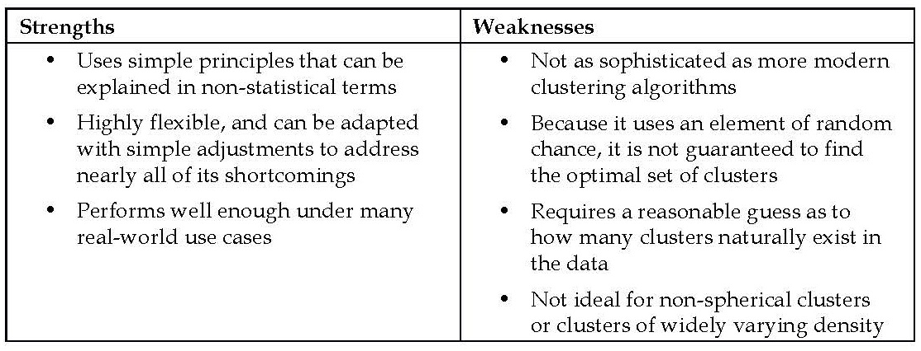
reasons why k-means is still used widely

Slide 11
locally optimal solutions
The k-means algorithm assigns each of the n examples to one of the k clusters, where k is a number that has been determined ahead of time.
The goal is to minimize the differences within each cluster and maximize the differences between the clusters.
Unless k and n are extremely small, it is not feasible to compute the optimal clusters across all the possible combinations of examples.
Instead, the algorithm uses a heuristic process that finds locally optimal solutions.
this means that it starts with an initial guess for the cluster assignments, and then modifies the assignments slightly to see whether the changes improve the homogeneity within the clusters.

Slide 12
two phases
First, it assigns examples to an initial set of k clusters.
Then, it updates the assignments by adjusting the cluster boundaries according to the examples that currently fall into the cluster.
The process of updating and assigning occurs several times until changes no longer improve the cluster fit.
At this point, the process stops and the clusters are finalized.
Due to the heuristic nature of k-means, you may end up with somewhat different final results by making only slight changes to the starting conditions.
If the results vary dramatically, this could indicate a problem.
  the data may not have natural groupings or
  the value of k has been poorly chosen.
it's a good idea to try a cluster analysis more than once to test the robustness of your findings.

Slide 13
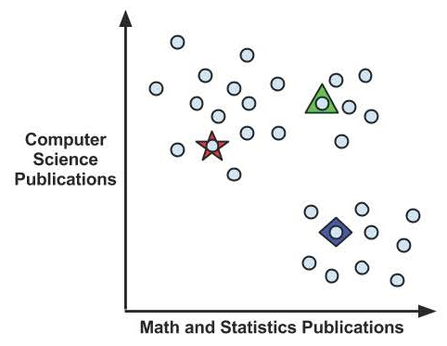
Using distance to assign and update clusters
k-means treats feature values as coordinates in a multidimensional feature space.
The k-means algorithm begins by choosing k points in the feature space to serve as the cluster centers.
These centers are the catalyst that spurs the remaining examples to fall into place.
Often, the points are chosen by selecting k random examples from the training dataset.

Slide 14
choosing the initial centers
As the k-means algorithm is highly sensitive to the starting position of the cluster centers, this means that random chance may have a substantial impact on the final set of clusters.
To address this problem, k-means can be modified to use different methods for choosing the initial centers.
For example, one variant chooses random values occurring anywhere in the feature space (rather than only selecting among the values observed in the data).
Another option is to skip this step altogether; by randomly assigning each example to a cluster, the algorithm can jump ahead immediately to the update phase.
Each of these approaches adds a particular bias to the final set of clusters, which you may be able to use to improve your results.

Slide 15
k-means++
In 2007, an algorithm called k-means++ was introduced, which proposes an alternative method for selecting the initial cluster centers.
It purports to be an efficient way to get much closer to the optimal clustering solution while reducing the impact of random chance.
For more information, refer to Arthur D, Vassilvitskii S. k-means++: The advantages of careful seeding. Proceedings of the eighteenth annual ACM-SIAM symposium on discrete algorithms. 2007:1027–1035.

Slide 16
distance functions
Traditionally, k-means uses Euclidean distance, but Manhattan distance or Minkowski distance are also sometimes used.
if n indicates the number of features, the formula for Euclidean distance between example x and example y is:
For instance, if we are comparing a guest with five computer science publications and one math publication to a guest with zero computer science papers and two math papers, we could compute this in R as follows:
> sqrt((5 - 0)^2 + (1 - 2)^2)
[1] 5.09902
as we are using distance calculations, all the features need to be numeric, and the values should be normalized to a standard range ahead of time.

Slide 17
Voronoi diagram
the vertex where all the three boundaries meet is the maximal distance from all three cluster centers.

Slide 18
update phase
The first step of updating the clusters involves shifting the initial centers to a new location, known as the centroid, which is calculated as the average position of the points currently assigned to that cluster.
The boundaries in the Voronoi diagram also shift.

Slide 19
another update phase
As a result of this reassignment, the k-means algorithm will continue through another update phase.

Slide 20
3rd update
Because two more points were reassigned, another update must occur, which moves the centroids and updates the cluster boundaries.
However, because these changes result in no reassignments, the k-means algorithm stops.
The cluster assignments are now final.

Slide 21
report the cluster
The final clusters can be reported in one of the two ways.
First, you might simply report the cluster assignments such as A, B, or C for each example.
Alternatively, you could report the coordinates of the cluster centroids after the final update.

Slide 22
Choosing the appropriate number of clusters
the algorithm is sensitive to the randomly-chosen cluster centers.
Similarly, k-means is sensitive to the number of clusters; the choice requires a delicate balance.
Setting k to be very large will improve the homogeneity of the clusters, and at the same time, it risks overfitting the data.
Ideally, you will have a priori knowledge (a prior belief) about the true groupings and you can apply this information to choosing the number of clusters.
Sometimes the number of clusters is dictated by business requirements or the motivation for the analysis.
Without any prior knowledge, one rule of thumb suggests setting k equal to the square root of (n / 2), where n is the number of examples in the dataset.
However, this rule of thumb is likely to result in an unwieldy number of clusters for large datasets.

Slide 23
elbow method
the elbow method attempts to gauge how the homogeneity or heterogeneity within the clusters changes for various values of k.
the homogeneity within clusters is expected to increase as additional clusters are added;
similarly, heterogeneity will also continue to decrease with more clusters.
the goal is not to maximize homogeneity or minimize heterogeneity, but rather to find k so that there are diminishing returns beyond that point.
This value of k is known as the elbow point.

Slide 24
elbow point

Slide 25
Practical issues
There are numerous statistics to measure homogeneity and heterogeneity within the clusters that can be used with the elbow method.
in practice, it is not always feasible to iteratively test a large number of k values.
This is in part because clustering large datasets can be fairly time consuming; clustering the data repeatedly is even worse.
Regardless, applications requiring the exact optimal set of clusters are fairly rare.
In most clustering applications, it suffices to choose a k value based on convenience rather than strict performance requirements.

Slide 26
setting k
By observing how the characteristics of the clusters change as k is varied, one might infer where the data have naturally defined boundaries.
Groups that are more tightly clustered will change a little, while less homogeneous groups will form and disband over time.
In general, it may be wise to spend little time worrying about getting k exactly right.
even a tiny bit of subject-matter knowledge can be used to set k such that actionable and interesting clusters are found.
As clustering is unsupervised, the task is really about what you make of it; the value is in the insights you take away from the algorithm's findings.

Slide 27
Example – finding teen market segments using k-means clustering
Interacting with friends on a social networking service (SNS), such as Facebook, Tumblr, and Instagram has become a rite of passage for teenagers around the world.
these adolescents are a coveted demographic for businesses hoping to sell snacks, beverages, electronics, and hygiene products.
One way to gain this edge is to identify segments of teenagers who share similar tastes, so that clients can avoid targeting advertisements to teens with no interest in the product being sold.
Given the text of teenagers' SNS pages, we can identify groups that share common interests such as sports, religion, or music.
Clustering can automate the process of discovering the natural segments in this population.
However, it will be up to us to decide whether or not the clusters are interesting and how we can use them for advertising.

Slide 28
Step 1 – collecting data
a dataset representing a random sample of 30,000 U.S. high school students who had profiles on a well-known SNS in 2006.
the profiles represent a fairly wide cross section of American adolescents in 2006.
This dataset was compiled by Brett Lantz while conducting sociological research on the teenage identities at the University of Notre Dame.
The full dataset is available at the Packt Publishing website with the filename snsdata.csv.

Slide 29
The data
The data was sampled evenly across four high school graduation years (2006 through 2009) representing the senior, junior, sophomore, and freshman classes at the time of data collection.
Using an automated web crawler, the full text of the SNS profiles were downloaded, and each teen's gender, age, and number of SNS friends was recorded.
A text mining tool was used to divide the remaining SNS page content into words.
From the top 500 words appearing across all the pages, 36 words were chosen to represent five categories of interests: namely extracurricular activities, fashion, religion, romance, and antisocial behavior.
The 36 words include terms such as football, sexy, kissed, bible, shopping, death, and drugs.
The final dataset indicates, for each person, how many times each word appeared in the person's SNS profile.

Slide 30
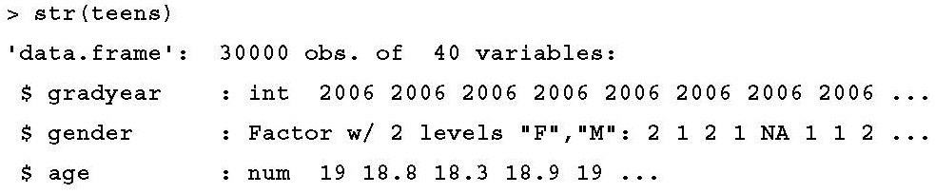
Step 2 – exploring and preparing the data
> teens <- read.csv("snsdata.csv")

Slide 31
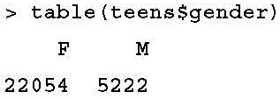
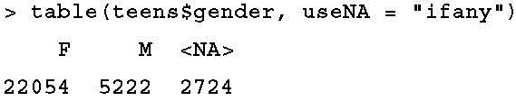
missing data
The NA is R's way of telling us that the record has a missing value
2,724 records (9 percent) have missing gender data

Slide 32
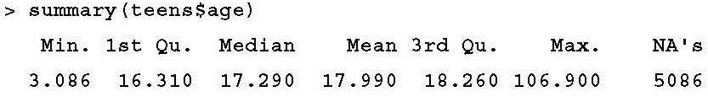
age
For numeric data, the summary() command tells us the number of missing NA values.
A total of 5,086 records (17 percent) have missing ages.
Also concerning is the fact that the minimum (3) and maximum (106) values seem to be unreasonable.
To ensure that these extreme values don't cause problems for the analysis, we'll need to clean them up before moving on.

Slide 33
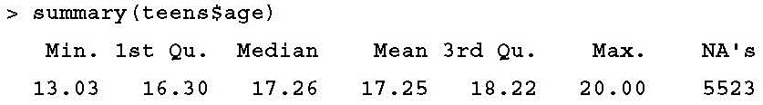
reasonable range of ages
A more reasonable range of ages for the high school students includes those who are at least 13 years old and not yet 20 years old.
Any age value falling outside this range should be treated the same as missing data.
> teens$age <- ifelse(teens$age >= 13 & teens$age < 20, teens$age, NA)
Unfortunately, now we've created an even larger missing data problem.

Slide 34
Data preparation – dummy coding missing values
An easy solution for handling the missing values is to exclude any record with a missing value.
The problem with this approach is that even if the missingness is not extensive, you can easily exclude large portions of the data.
The larger the number of missing values present in a dataset, the more likely it is that any given record will be excluded.
Fairly soon, you will be left with a tiny subset of data, or worse, the remaining records will be systematically different or nonrepresentative of the full population.

Slide 35
solution for categorical variables
An alternative solution for categorical variables like gender is to treat a missing value as a separate category.
For instance, rather than limiting to female and male, we can add an additional category for the unknown gender.
This allows us to utilize dummy coding.
dummy coding involves creating a separate binary (1 or 0) valued dummy variable for each level of a nominal feature except one, which is held out to serve as the reference group.
The reason one category can be excluded is because its status can be inferred from the other categories.

Slide 36
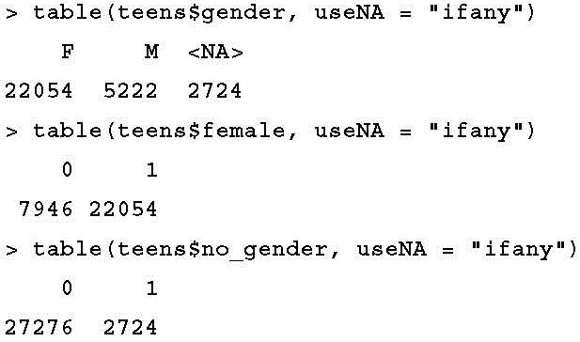
create dummy variables for female and unknown gender
> teens$female <- ifelse(teens$gender == "F" & !is.na(teens$gender), 1, 0)
> teens$no_gender <- ifelse(is.na(teens$gender), 1, 0)

Slide 37
Data preparation – imputing the missing values
Imputation - filling in the missing data with a guess as to the true value.
Most people in a graduation cohort were born within a single calendar year.
If we can identify the typical age for each cohort, we would have a fairly reasonable estimate of the age of a student in that graduation year.
One way to find a typical value is by calculating the average or mean value.

Slide 38
calculating the mean value
> mean(teens$age)
[1] NA
The issue is that the mean is undefined for a vector containing missing data.
> mean(teens$age, na.rm = TRUE)
[1] 17.25243
we actually need the average age for each graduation year.

Slide 39
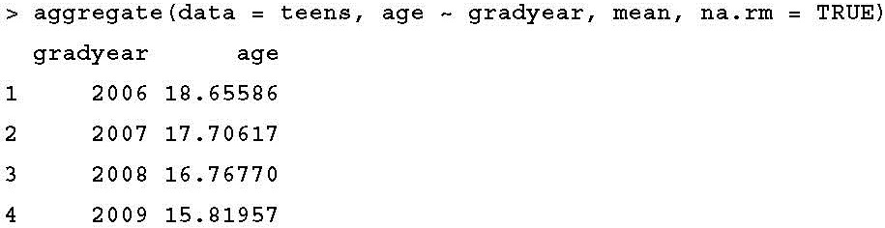
the aggregate() function
the aggregate() function computes statistics for subgroups of data.
The aggregate() output is a data frame.
This requires extra work to merge back onto our original data.

Slide 40

the ave() function
the ave() function returns a vector with the group means repeated so that the result is equal in length to the original vector:
> ave_age <- ave(teens$age, teens$gradyear, FUN = function(x) mean(x, na.rm = TRUE))
To impute these means onto the missing values:
> teens$age <- ifelse(is.na(teens$age), ave_age, teens$age)

Slide 41
Step 3 – training a model on the data
the kmeans() function in the stats package is widely used and provides a vanilla implementation of the algorithm.
The kmeans() function requires a data frame containing only numeric data and a parameter specifying the desired number of clusters.

Slide 42
the 36 features
considering only the 36 features that represent the number of times various interests appeared on the teen SNS profiles.
> interests <- teens[5:40]
apply the z-score standardization to the interests data frame:
> interests_z <- as.data.frame(lapply(interests, scale))
deciding how many clusters to use for segmenting the data.
  If we use too many clusters, we may find them too specific to be useful;
  conversely, choosing too few may result in heterogeneous groupings.
Choosing the number of clusters is easier if you are familiar with the analysis population.

Slide 43
The Breakfast Club
The Breakfast Club - a coming-of-age comedy released in 1985 and directed by John Hughes.
The teenage characters in this movie are identified in terms of five stereotypes: a brain, an athlete, a basket case, a princess, and a criminal.
Given that these identities prevail throughout popular teen fiction, five seems like a reasonable starting point for k.
Because the k-means algorithm utilizes random starting points, the set.seed() function is used:
> set.seed(2345)
> teen_clusters <- kmeans(interests_z, 5)

Slide 44
Step 4 – evaluating model performance
Evaluating clustering results can be somewhat subjective.
Ultimately, the success or failure of the model hinges on whether the clusters are useful for their intended purpose.
As the goal of this analysis was to identify clusters of teenagers with similar interests for marketing purposes, we will largely measure our success in qualitative terms.
Examine the number of examples falling in each of the groups.
> teen_clusters$size
[1] 871 600 5981 1034 21514

Slide 45
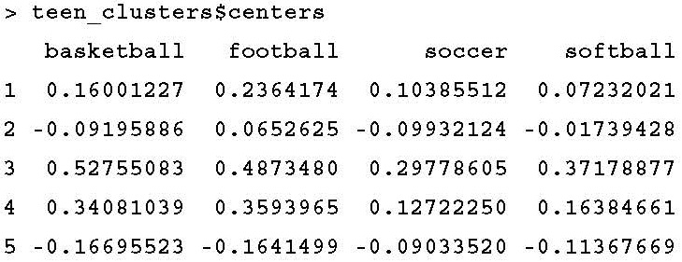
the coordinates of the cluster centroids
examine the coordinates of the cluster centroids using the teen_clusters$centers component
The rows of the output (labeled 1 to 5) refer to the five clusters
the numbers across each row indicate the cluster's average value for the interest listed at the top of the column.

Slide 47
patterns
By examining whether the clusters fall above or below the mean level for each interest category, we can begin to notice patterns that distinguish the clusters from each other.
Cluster 3 is substantially above the mean interest level on all the sports.
This suggests that this may be a group of Athletes per The Breakfast Club stereotype.
Cluster 1 includes the most mentions of "cheerleading," the word "hot," and is above the average level of football interest. Are these the so-called Princesses?
Cluster 5 is distinguished by the fact that it is unexceptional; its members had lower-than-average levels of interest in every measured activity.
It is also the single largest group in terms of the number of members.
One potential explanation is that these users created a profile on the website but never posted any interests.

Slide 48
the dominant interests of each of the groups

Slide 49
Step 5 – improving model performance
the algorithm appears to be performing quite well.
Therefore, we can now focus our effort on turning these insights into action.
We'll begin by applying the clusters back onto the full dataset.
The teen_clusters object created by the kmeans() function includes a component named cluster that contains the cluster assignments for all 30,000 individuals in the sample.
We can add this as a column on the teens data frame with the following command:
> teens$cluster <- teen_clusters$cluster

Slide 50
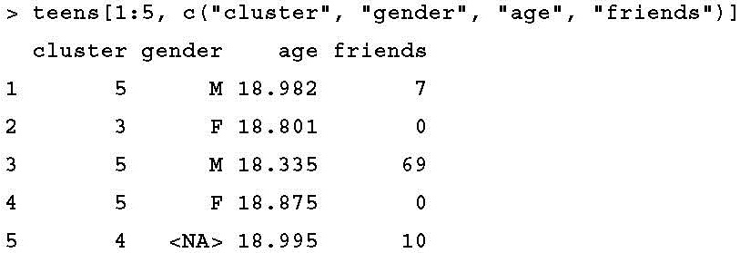
the personal information for the first five teens in the SNS data:

Slide 51
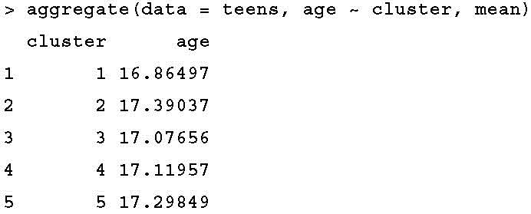
demographic characteristics of the clusters
The mean age does not vary much by cluster, which is not too surprising as these teen identities are often determined before high school

Slide 52
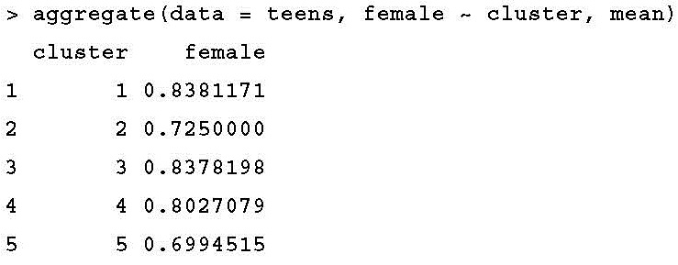
proportion of females by cluster
there are some substantial differences in the proportion of females by cluster
Cluster 1, the so-called Princesses, is nearly 84 percent female
Cluster 2 and Cluster 5 are only about 70 percent female.
These disparities imply that there are differences in the interests that teen boys and girls discuss on their social networking pages.

Slide 53
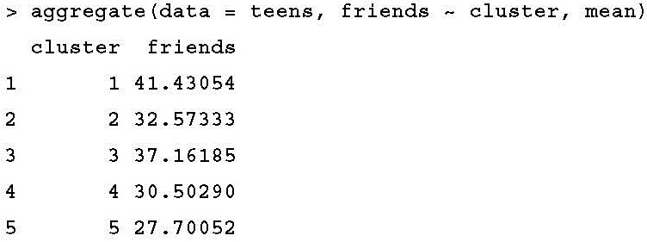
number of friends
On an average, Princesses have the most friends (41.4), followed by Athletes (37.2) and Brains (32.6). On the low end are Criminals (30.5) and Basket Cases (27.7).
Also interesting is the fact that the number of friends seems to be related to the stereotype of each clusters' high school popularity; the stereotypically popular groups tend to have more friends.

Slide 54
The End of Chapter 9

