Slide 1
Chapter 8
Finding Patterns – Market Basket Analysis Using Association Rules

Slide 2
market basket analysis
impulse buys are no coincidence, as retailers use sophisticated data analysis techniques to identify patterns that will drive retail behavior.
In years past, such recommendation systems were based on the subjective intuition of marketing professionals and inventory managers or buyers.
More recently, as barcode scanners, computerized inventory systems, and online shopping trends have built a wealth of transactional data, machine learning has been increasingly applied to learn purchasing patterns.
The practice is commonly known as market basket analysis due to the fact that it has been so frequently applied to supermarket data.

Slide 3
the work
Although the technique originated with shopping data, it is useful in other contexts as well.
Generally, the work involves:
  Using simple performance measures to find associations in large databases
  Understanding the peculiarities of transactional data
  Knowing how to identify the useful and actionable patterns
The results of a market basket analysis are actionable patterns.

Slide 4
Understanding association rules
The building blocks of a market basket analysis are the items that may appear in any given transaction.
Itemset: Group of one or more items surrounded by brackets, e.g.,
The result of a market basket analysis is a collection of association rules that specify patterns found in the relationships among items in the itemsets.
The LHS is the condition that needs to be met in order to trigger the rule, and the RHS is the expected result of meeting that condition.

Slide 5
unsupervised knowledge discovery
Developed in the context of retail transaction databases, association rules are not used for prediction, but rather for unsupervised knowledge discovery in large databases.
Because association rule learners are unsupervised, there is no need for the algorithm to be trained; data does not need to be labeled ahead of time.
The program is to find interesting associations from the dataset.
The downside is that there isn't an easy way to objectively measure the performance of a rule learner, aside from evaluating them for qualitative usefulness

Slide 6
Potential applications
Although association rules are most often used for market basket analysis, they are helpful for finding patterns in many different types of data.
Other potential applications include:
  Searching for interesting and frequently occurring patterns of DNA and protein sequences in cancer data
  Finding patterns of purchases or medical claims that occur in combination with fraudulent credit card or insurance use
  Identifying combinations of behavior that precede customers dropping their cellular phone service or upgrading their cable television package

Slide 7
The Apriori algorithm for association rule learning
Transactional datasets are typically extremely large, both in terms of the number of transactions as well as the number of items or features that are monitored.
The problem is that the number of potential itemsets grows exponentially with the number of features.
Given k items that can appear or not appear in a set, there are 2^k possible itemsets that could be potential rules.
A retailer that sells only 100 different items could have on the order of 2^100 = 1.27e+30 itemsets that an algorithm must evaluate.

Slide 8
limit the scope of the search
in reality, many of the potential combinations of items are rarely, if ever, found in practice.
For instance, even if a store sells both automotive items and women's cosmetics, a set of {motor oil, lipstick} is likely to be extraordinarily uncommon.
By ignoring these rare (and, perhaps, less important) combinations, it is possible to limit the scope of the search for rules to a more manageable size.

Slide 9
Apriori
Perhaps the most-widely used approach for efficiently searching large databases for rules is known as Apriori.
Introduced in 1994 by Rakesh Agrawal and Ramakrishnan Srikant, the Apriori algorithm has since become somewhat synonymous with association rule learning.
The name is derived from the fact that the algorithm utilizes a simple prior (that is, a priori) belief about the properties of frequent itemsets.

Slide 10
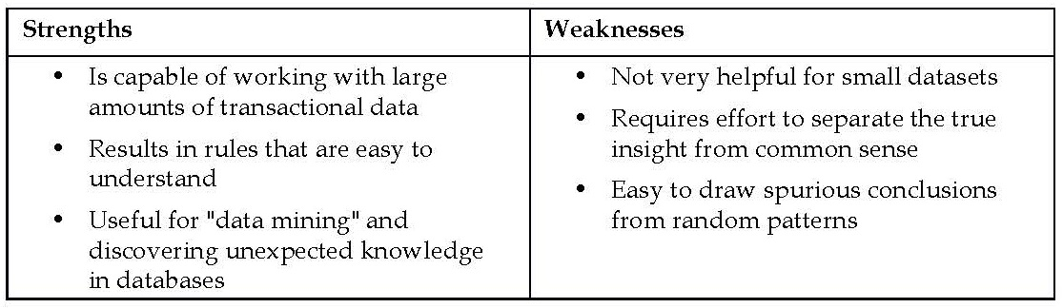
strengths and weaknesses

Slide 11
Apriori property
the Apriori algorithm employs a simple a priori belief to reduce the association rule search space: all subsets of a frequent itemset must also be frequent.
This heuristic is known as the Apriori property.
For example, the set {motor oil, lipstick} can only be frequent if both {motor oil} and {lipstick} occur frequently as well.
Consequently, if either motor oil or lipstick is infrequent, any set containing these items can be excluded from the search.

Slide 12
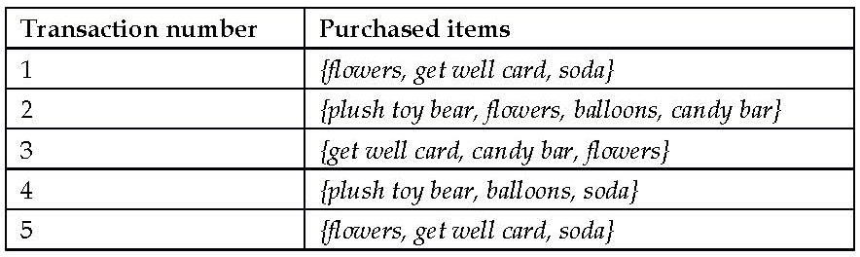
An example
The following table shows five completed transactions in an imaginary hospital's gift shop:
one can infer that there are a couple of typical buying patterns.
A person visiting a sick friend or family member tends to buy a get well card and flowers,
visitors to new mothers tend to buy plush toy bears and balloons.
In a similar fashion, the Apriori algorithm uses statistical measures of an itemset's "interestingness" to locate association rules in much larger transaction databases.

Slide 13
Measuring rule interest – support and confidence
Whether or not an association rule is deemed interesting is determined by two statistical measures: support and confidence measures.
By providing minimum thresholds for each of these metrics and applying the Apriori principle, it is easy to drastically limit the number of rules reported, perhaps even to the point where only the obvious or common sense rules are identified.
The support of an itemset or rule measures how frequently it occurs in the data.
For instance the itemset {get well card, flowers}, has support of 3 / 5 = 0.6 in the hospital gift shop data.
Similarly, the support for {get well card} → {flowers} is also 0.6.
The support can be calculated for any itemset or even a single item;
for instance, the support for {candy bar} is 2 / 5 = 0.4, since candy bars appear in 40 percent of purchases.

Slide 14
defining support and confidence
A function defining support for the itemset X:
N is the number of transactions in the database and count(X) is the number of transactions containing itemset X.
A rule's confidence is a measurement of its predictive power or accuracy.
It is defined as the support of the itemset containing both X and Y divided by the support of the itemset containing only X:

Slide 15
Interpretation
Essentially, the confidence tells us the proportion of transactions where the presence of item or itemset X results in the presence of item or itemset Y.
The confidence that X leads to Y is not the same as the confidence that Y leads to X.
For example, the confidence of {flowers} → {get well card} is 0.6 / 0.8 = 0.75.
In comparison, the confidence of {get well card} → {flowers} is 0.6 / 0.6 = 1.0.
This means that a purchase involving flowers is accompanied by a purchase of a get well card 75 percent of the time, while a purchase of a get well card is associated with flowers 100 percent of the time.

Slide 16
similarities between support, confidence, and the Bayesian probability rules
support(A, B) is the same as P(A∩B) and confidence(A → B) is the same as P(B|A).
Rules like {get well card} → {flowers} are known as strong rules, because they have both high support and confidence.
Apriori algorithm uses the minimum levels of support and confidence with the Apriori principle to find strong rules quickly by reducing the number of rules to a more manageable level

Slide 17
Building a set of rules with the Apriori principle
the Apriori principle states that all subsets of a frequent itemset must also be frequent.
In other words, if {A, B} is frequent, then {A} and {B} must both be frequent.
if we know that {A} does not meet a desired support threshold, there is no reason to consider {A, B} or any itemset containing {A}.
The actual process of creating rules occurs in two phases:
  1. Identifying all the itemsets that meet a minimum support threshold.
  2. Creating rules from these itemsets using those meeting a minimum confidence threshold.

Slide 18
The first phase
The first phase occurs in multiple iterations.
Each successive iteration involves evaluating the support of a set of increasingly large itemsets.
For instance, iteration 1 involves evaluating the set of 1-item itemsets (1-itemsets), iteration 2 evaluates 2-itemsets, and so on.
The result of each iteration i is a set of all the i-itemsets that meet the minimum support threshold.
All the itemsets from iteration i are combined in order to generate candidate itemsets for the evaluation in iteration i + 1.
If {A}, {B}, and {C} are frequent in iteration 1 while {D} is not frequent, iteration 2 will consider only {A, B}, {A, C}, and {B, C}.

Slide 19
the second phase
suppose during iteration 2, it is discovered that {A, B} and {B, C} are frequent, but {A, C} is not.
Although iteration 3 would normally begin by evaluating the support for {A, B, C}, it is not mandatory that this step should occur at all.
The Apriori principle states that {A, B, C} cannot possibly be frequent, since the subset {A, C} is not.
At this point, the second phase of the Apriori algorithm may begin.
Given the set of frequent itemsets, association rules are generated from all possible subsets.
For instance, {A, B} would result in candidate rules for {A} → {B} and {B} → {A}.
These are evaluated against a minimum confidence threshold, and any rule that does not meet the desired confidence level is eliminated.

Slide 20
Example – identifying frequently purchased groceries with association rules
market basket analysis is used behind the scenes for the recommendation systems used in many brick-and-mortar and online retailers.
The learned association rules indicate the combinations of items that are often purchased together.
Knowledge of these patterns provides insight into new ways a grocery chain might optimize the inventory, advertise promotions, or organize the physical layout of the store.
For instance, if shoppers frequently purchase coffee or orange juice with a breakfast pastry, it may be possible to increase profit by relocating pastries closer to coffee and juice.
the techniques could be applied to many different types of problems, from movie recommendations, to dating sites, to finding dangerous interactions among medications.

Slide 21
Step 1 – collecting data
the purchase data collected from one month of operation at a real-world grocery store.
The data contains 9,835 transactions or about 327 transactions per day (roughly 30 transactions per hour in a 12-hour business day), suggesting that the retailer is not particularly large, nor is it particularly small.
The dataset used here was adapted from the Groceries dataset in the arules R package.
see: Hahsler M, Hornik K, Reutterer T. Implications of probabilistic data modeling for mining association rules. In: Gaul W, Vichi M, Weihs C, ed. Studies in Classification, Data Analysis, and Knowledge Organization: from Data and Information Analysis to Knowledge Engineering. New York: Springer; 2006:598–605.

Slide 22
manageable types
The typical grocery store offers a huge variety of items. There might be five brands of milk, a dozen different types of laundry detergent, and three brands of coffee.
Given the moderate size of the retailer, we will assume that they are not terribly concerned with finding rules that apply only to a specific brand of milk or detergent.
all brand names can be removed from the purchases.
This reduces the number of groceries to a more manageable 169 types, using broad categories such as chicken, frozen meals, margarine, and soda.

Slide 23
Step 2 – exploring and preparing the data
transactional data is a more free form.
As usual, each row in the data specifies a single example—in this case, a transaction.
However, rather than having a set number of features, each record comprises a comma-separated list of any number of items, from one to many.
In essence, the features may differ from example to example.
download the groceries.csv file from the Packt Publishing website

Slide 24
raw grocery.csv file
The first five rows of the raw grocery.csv file are as follows:
  citrus fruit, semi-finished bread, margarine, ready soups
  tropical fruit, yogurt, coffee
  whole milk
  pip fruit, yogurt, cream cheese, meat spreads
  other vegetables, whole milk, condensed milk, long life bakery product
These lines indicate five separate grocery store transactions.

Slide 25
read.csv()?
Suppose we try to load the data using the read.csv() function, R would read the data into a matrix form as follows:
R chose to create four variables because the first line had exactly four comma-separated values.
However, we know that grocery purchases can contain more than four items.

Slide 26
Data preparation – creating a sparse matrix for transaction data
The solution to this problem utilizes a data structure called a sparse matrix.
Each row in the sparse matrix indicates a transaction.
the sparse matrix has a column (that is, feature) for every item that could possibly appear in someone's shopping bag.
Since there are 169 different items in our grocery store data, our sparse matrix will contain 169 columns.
a conventional data structure quickly becomes too large to fit in the available memory.
Even with the relatively small transactional dataset used here, the matrix contains nearly 1.7 million cells, most of which contain zeros.
Since there is no benefit to storing all these zero values, a sparse matrix does not actually store the full matrix in memory; it only stores the cells that are occupied by an item.

Slide 27
read.transactions() function
use the functionality provided by the arules package.
Install and load the package using the install.packages("arules") and library(arules) commands.
arules provides a read.transactions() function that is similar to read.csv() with the exception that it results in a sparse matrix suitable for transactional data.
The sep = "," parameter specifies that items in the input file are separated by a comma.
> groceries <- read.transactions("groceries.csv", sep = ",")

Slide 28
summary(groceries)
Each cell in the matrix is 1 if the item was purchased for the corresponding transaction, or 0 otherwise.
> summary(groceries)
transactions as itemMatrix in sparse format with
9835 rows (elements/itemsets/transactions) and
169 columns (items) and a density of 0.02609146
The density value of 0.02609146 (2.6 percent) refers to the proportion of nonzero matrix cells.
Since there are 9,835 * 169 = 1,662,115 positions in the matrix, we can calculate that a total of 1,662,115 * 0.02609146 = 43,367 items were purchased during the store's 30 days of operation (ignoring the fact that duplicates of the same items might have been purchased).
With an additional step, we can determine that the average transaction contained 43,367 / 9,835 = 4.409 distinct grocery items.

Slide 29
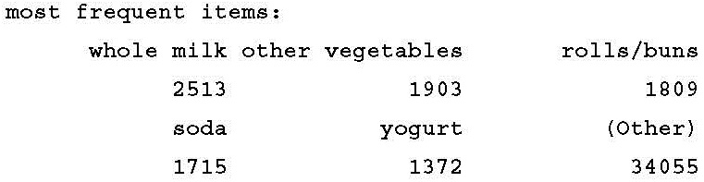
most commonly found items
The next block of the summary() output lists the items that were most commonly found in the transactional data.
Since 2,513 / 9,835 = 0.2555, we can determine that whole milk appeared in 25.6 percent of the transactions.

Slide 30
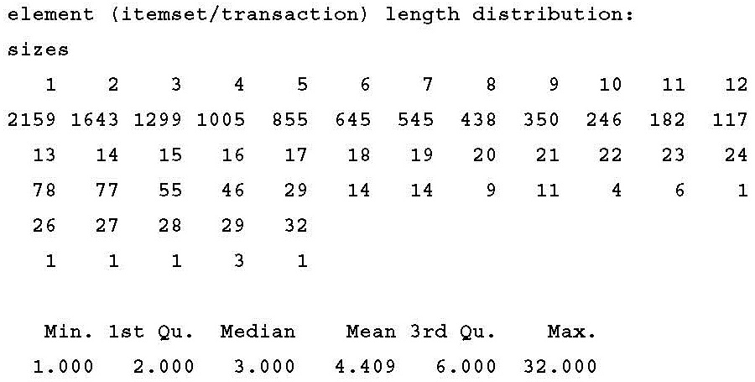
size of the transactions
A total of 2,159 transactions contained only a single item, while one transaction had 32 items.
The first quartile and median purchase sizes are two and three items, respectively, implying that 25 percent of the transactions contained two or fewer items and the transactions were split in half between those with less than three items and those with more.

Slide 31
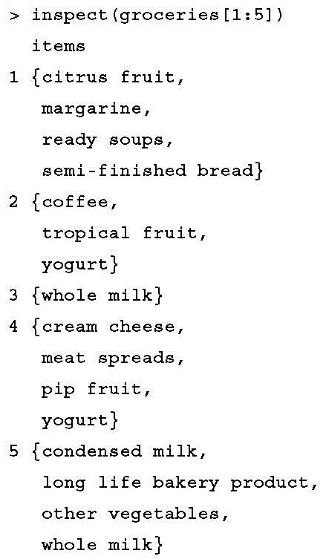
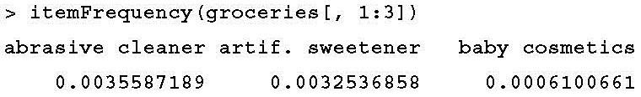
inspect() function
itemFrequency() function allows us to see the proportion of transactions that contain the item.
This allows us to view the support level for the first three items in the grocery data.
Note that the items in the sparse matrix are sorted in columns by alphabetical order.

Slide 32
Visualizing item support – item frequency plots
itemFrequencyPlot() function allows you to produce a bar chart depicting the proportion of transactions containing certain items.
If you require these items to appear in a minimum proportion of transactions, use itemFrequencyPlot() with the support parameter:
> itemFrequencyPlot(groceries, support = 0.1)
As shown in the following plot, this results in a histogram showing the eight items in the groceries data with at least 10 percent support:

Slide 33
topN parameter
If you would rather limit the plot to a specific number of items, the topN parameter can be used with itemFrequencyPlot():
> itemFrequencyPlot(groceries, topN = 20)
The histogram is then sorted by decreasing support, as shown in the following diagram of the top 20 items in the groceries data:

Slide 34
Visualizing the transaction data – plotting the sparse matrix
it's also possible to visualize the entire sparse matrix useing the image() function.
The command to display the sparse matrix for the first five transactions is as follows:
> image(groceries[1:5])
The resulting diagram depicts a matrix with 5 rows and 169 columns, indicating the 5 transactions and 169 possible items we requested.

Slide 35
actionable insights
patterns in the diagram may help reveal actionable insights within the transactions and items, particularly if the data is sorted in interesting ways.
For example, if the transactions are sorted by date, the patterns in black dots could reveal seasonal effects in the number or types of items purchased. Perhaps around Christmas or Hanukkah, toys are more common; around Halloween, perhaps candies become popular.
This type of visualization could be especially powerful if the items were also sorted into categories.

Slide 36
creates a matrix diagram with 100 rows and 169 columns
> image(sample(groceries, 100))

Slide 37
Step 3 – training a model on the data

Slide 38
support and confidence parameters
there can sometimes be a fair amount of trial and error needed to find the support and confidence parameters that produce a reasonable number of association rules.
If you set these levels too high, you might find no rules or rules that are too generic to be very useful.
On the other hand, a threshold too low might result in an unwieldy number of rules, or worse, the operation might take a very long time or run out of memory during the learning phase.
In this case, if we attempt to use the default settings of support = 0.1 and
confidence = 0.8, we will end up with a set of zero rules:
> apriori(groceries)
set of 0 rules

Slide 39
setting a minimum support threshold
think about the smallest number of transactions you would need before you would consider a pattern interesting.
For instance, you could argue that if an item is purchased twice a day (about 60 times in a month of data), it may be an interesting pattern.
Since 60 out of 9,835 equals 0.006, we'll try setting the support there first.

Slide 40
Setting the minimum confidence
Setting the minimum confidence involves a delicate balance.
if confidence is too low, we might be overwhelmed with a large number of unreliable rules.
if we set confidence too high, we will be limited to the rules that are obvious or inevitable—similar to the fact that smoke detectors are always purchased in combination with batteries.
The appropriate minimum confidence level depends a great deal on the goals of your analysis.
If you start with a conservative value, you can always reduce it to broaden the search if you aren't finding actionable intelligence.

Slide 41
minlen
it is helpful to set minlen = 2 to eliminate rules that contain fewer than two items.
This prevents uninteresting rules from being created simply because the item is purchased frequently, for instance, {} → whole milk. This rule meets the minimum support and confidence because whole milk is purchased in over 25 percent of the transactions, but it isn't a very actionable insight.
The full command to find a set of association rules using the Apriori algorithm is as follows:
> groceryrules <- apriori(groceries, parameter = list(support = 0.006, confidence = 0.25, minlen = 2))
> groceryrules
set of 463 rules

Slide 42
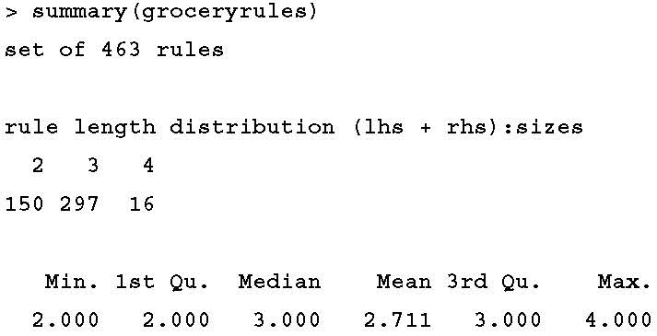
Step 4 – evaluating model performance
the size of the rule is calculated as the total of both the left-hand side (lhs) and right-hand side (rhs) of the rule.
This means that a rule like {bread} → {butter} is two items and {peanut butter, jelly} → {bread} is three.

Slide 43
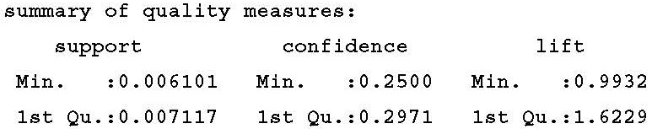
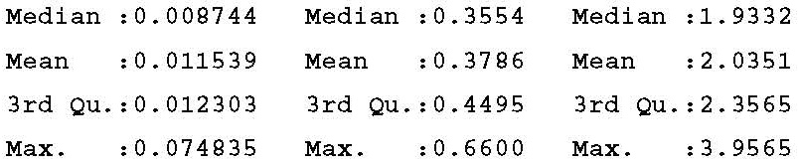
rule quality measures

Slide 44
The lift
The lift of a rule measures how much more likely one item or itemset is purchased relative to its typical rate of purchase, given that you know another item or itemset has been purchased.
This is defined by the following equation:
Unlike confidence where the item order matters, lift(X → Y) is the same as lift(Y → X).
if lift(milk → bread) is greater than one, it implies that the two items are found together more often than one would expect by chance.
A large lift value is therefore a strong indicator that a rule is important, and reflects a true connection between the items.

Slide 45
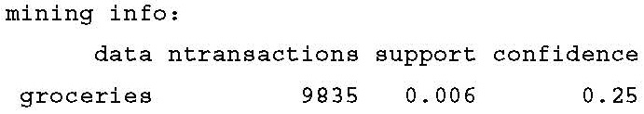
mining information
In the final section of the summary() output, we receive mining information, telling us about how the rules were chosen.
We can take a look at specific rules using the inspect() function.

Slide 46
three categories
Does {potted plants} → {wholemilk} seem like a very useful rule?
Yet our data suggests otherwise. How can we make sense of this fact?
A common approach is to take the association rules and divide them into the following three categories:
  Actionable
  Trivial
  Inexplicable
Obviously, the goal of a market basket analysis is to find actionable rules that provide a clear and useful insight.
Some rules are clear, others are useful; it is less common to find a combination of both of these factors.

Slide 47
trivial and inexplicable rules
So-called trivial rules include any rules that are so obvious that they are not worth mentioning—they are clear, but not useful.
E.g., {diapers} → {formula}
Rules are inexplicable if the connection between the items is so unclear that figuring out how to use the information is impossible or nearly impossible.
The rule may simply be a random pattern in the data, for instance, a rule stating that {pickles} → {chocolate ice cream} may be due to a single customer, whose pregnant wife had regular cravings for strange combinations of foods.

Slide 48
Step 5 – improving model performance
Sorting the set of association rules
The arules package includes a sort() function that can be used to reorder the list of rules so that the ones with the highest or lowest values of the quality measure come first.
To reorder the groceryrules object, we can apply sort() while specifying a "support", "confidence", or "lift" value to the by parameter.
By combining the sort function with vector operators, we can obtain a specific number of interesting rules.
For instance, the best five rules according to the lift statistic can be examined using the following command:
> inspect(sort(groceryrules, by = "lift")[1:5])

Slide 49
> inspect(sort(groceryrules, by = "lift")[1:5])
These output is shown as follows:
The first rule, with a lift of about 3.96, implies that people who buy herbs are nearly four times more likely to buy root vegetables than the typical customer.

Slide 50
Taking subsets of association rules
The subset() function provides a method to search for subsets of transactions, items, or rules.
To use it to find any rules with berries appearing in the rule, use the following command. It will store the rules in a new object titled berryrules:
> berryrules <- subset(groceryrules, items %in% "berries")
We can then inspect the rules as we did with the larger set:
> inspect(berryrules)

Slide 51
> inspect(berryrules)
The result is the following set of rules:
There are four rules involving berries, two of which seem to be interesting enough to be called actionable.

Slide 52
keywords and operators
The subset() function is very powerful. The criteria for choosing the subset can be defined with several keywords and operators:
  The keyword items explained previously, matches an item appearing anywhere in the rule. To limit the subset to where the match occurs only on the left- or right-hand side, use lhs and rhs instead.
  The operator %in% means that at least one of the items must be found in the list you defined. If you want any rules matching either berries or yogurt, you could write items %in% c("berries", "yogurt”).
  Additional operators are available for partial matching (%pin%) and complete matching (%ain%). Partial matching allows you to find both citrus fruit and tropical fruit using one search: items %pin% "fruit". Complete matching requires that all the listed items are present. For instance, items %ain% c("berries", "yogurt") finds only rules with both berries and yogurt.
  Subsets can also be limited by support, confidence, or lift. For instance, confidence > 0.50 would limit you to the rules with confidence greater than 50 percent.
  Matching criteria can be combined with the standard R logical operators such as and (&), or (|), and not (!).

Slide 53
Saving association rules to a file or data frame
To share the results of your market basket analysis, you can save the rules to a CSV file with the write() function. This will produce a CSV file that can be used in most spreadsheet programs including Microsoft Excel:
> write(groceryrules, file = "groceryrules.csv", sep = ",", quote = TRUE, row.names = FALSE)

Slide 54
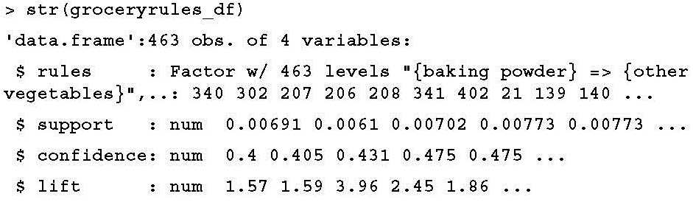
convert the rules into an R data frame
Sometimes it is also convenient to convert the rules into an R data frame. This can be accomplished easily using the as() function, as follows:
> groceryrules_df <- as(groceryrules, "data.frame")
This creates a data frame with the rules in the factor format, and numeric vectors for support, confidence, and lift:

Slide 55
The End of Chapter 8

