Slide 1
Chapter 6
Forecasting Numeric Data – Regression Methods

Slide 2
Goals of the chapter
Mathematical relationships expressed with exact numbers
  an additional 250 kilocalories consumed daily may result in nearly a kilogram of weight gain per month;
  each year of job experience may be worth an additional $1,000 in yearly salary;
  a president is more likely to be re-elected when the economy is strong
introducing techniques for estimating relationships among numeric data
  The basic statistical principles used in regression, a technique that models the size and the strength of numeric relationships
  How to prepare data for regression analysis, and estimate and interpret a regression model
  A pair of hybrid techniques known as regression trees and model trees, which adapt decision tree classifiers for numeric prediction tasks

Slide 3
Understanding regression
Regression is concerned with specifying the relationship between a single numeric dependent variable (the value to be predicted) and one or more numeric independent variables (the predictors).
The simplest forms of regression assume that the relationship between the independent and dependent variables follows a straight line.
slope-intercept form similar to y = a + bx
  slope term b specifies how much the line rises for each increase in x.
    Positive values define lines that slope upward while negative values define lines that slope downward.
  The term a is known as the intercept because it specifies the point where the line crosses, or intercepts, the vertical y axis. It indicates the value of y when x = 0

Slide 4
Examples
identify values of a and b so that the specified line is best able to relate the supplied x values to the values of y
quantify the margin of error

Slide 5
use cases
Regression analysis is commonly used for
  modeling complex relationships among data elements,
  estimating the impact of a treatment on an outcome,
  extrapolating into the future.
Some specific use cases include:
  Examining how populations and individuals vary by their measured characteristics, for use in scientific research across fields as diverse as economics, sociology, psychology, physics, and ecology
  Quantifying the causal relationship between an event and the response, such as those in clinical drug trials, engineering safety tests, or marketing research
  Identifying patterns that can be used to forecast future behavior given known criteria, such as predicting insurance claims, natural disaster damage, election results, and crime rates

Slide 6
also used for
statistical hypothesis testing determines whether a premise is likely to be true or false in light of the observed data.
Regression analysis is not synonymous with a single algorithm.
it is an umbrella for a large number of methods that can be adapted to nearly any machine learning task
linear regression models—those that use straight lines.
When there is only a single independent variable it is known as simple linear regression.
In the case of two or more independent variables, this is known as multiple linear regression, or simply "multiple regression".
Both of these techniques assume that the dependent variable is measured on a continuous scale

Slide 7
used for other types of dependent variables
logistic regression is used to model a binary categorical outcome
Poisson regression
  named after the French mathematician Siméon Poisson
  models integer count data
multinomial logistic regression models a categorical outcome
Generalized Linear Models (GLM) - linear models can be generalized to other patterns via the use of a link function, which specifies more complex forms for the relationship between x and y

Slide 8
Simple linear regression
Catastrophic disintegration of the United States space shuttle Challenger
  January 28, 1986, seven crew members killed
Aftermath:
  launch temperature as a potential culprit.
  The rubber O-rings responsible for sealing the rocket joints had never been tested below 40ºF (4ºC)
  the weather on the launch day was unusually cold and below freezing.
the accident has been a case study for the importance of data analysis and visualization
  it is undeniable that better data, utilized carefully, might very well have averted this disaster
  A regression model that demonstrated a link between temperature and O-ring failure, and could forecast the chance of failure given the expected temperature at launch, might have been very helpful

Slide 9
23 previous successful shuttle launches
Since the shuttle has a total of six primary O-rings, up to six distresses can occur per flight.
Though the rocket can survive one or more distress events, or fail with as few as one, each additional distress increases the probability of a catastrophic failure.

Slide 10
A simple linear regression model
performing a regression analysis involves finding parameter estimates for α and β.
The parameter estimates for alpha and beta are often denoted using a and b.
Suppose a = 3.70 and b = -0.048.

Slide 11
Risk Analysis
at 60 degrees Fahrenheit, we predict just under one O-ring distress.
At 70 degrees Fahrenheit, we expect around 0.3 failures.
If we extrapolate our model to 31 degrees—the forecasted temperature for the Challenger launch—we would expect about 3.70 - 0.048 * 31 = 2.21 O-ring distress events.
the Challenger launch at 31 degrees was nearly three times more risky than the typical launch at 60 degrees, and over eight times more risky than a launch at 70 degrees.

Slide 12
Ordinary least squares estimation
Ordinary Least Squares (OLS)
  the slope and intercept are chosen so that they minimize the sum of the squared errors, that is, the vertical distance between the predicted y value and the actual y value.
  These errors are known as residuals

Slide 13
goal of OLS regression
minimizing the following equation:
The solution for a:
the value of b that results in the minimum squared error is:

Slide 14
Simplify the formular
the variance of x
the covariance function for x and y
rewrite the formula for b as:

Slide 15
apply to the rocket launch data
download the challenger.csv file from the Packt Publishing website
> launch <- read.csv("challenger.csv")
> b <- cov(launch$temperature, launch$distress_ct) / var(launch$temperature)
> b
[1] -0.04753968
> a <- mean(launch$distress_ct) - b * mean(launch$temperature)
> a
[1] 3.698413

Slide 16
Correlations
The correlation between two variables is a number that indicates how closely their relationship follows a straight line.
Correlation typically refers to Pearson's correlation coefficient
  developed by the 20th century mathematician Karl Pearson.
The correlation ranges between -1 and +1.
The extreme values indicate a perfectly linear relationship.
a correlation close to zero indicates the absence of a linear relationship.

Slide 17
correlation between the launch temperature and the number of O-ring distress events
> r <- cov(launch$temperature, launch$distress_ct) / (sd(launch$temperature) * sd(launch$distress_ct))
> r
[1] -0.5111264
> cor(launch$temperature, launch$distress_ct)
[1] -0.5111264
there is a moderately strong negative linear association between temperature and O-ring distress

Slide 18
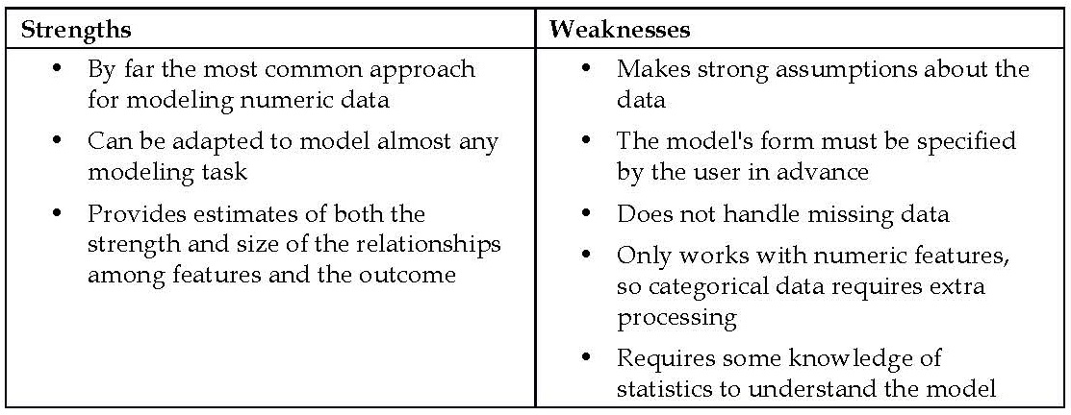
Multiple linear regression
The strengths and weaknesses of multiple linear regression:

Slide 19
Multiple regression equation
Error term - residual term
y changes by the amount β_{i} for each unit increase in x_{i}
intercept α is the expected value of y when the independent variables are all zero
intercept term α is also sometimes denoted as β₀
term x₀ is a constant with the value 1:

Slide 20
estimate the values of the regression parameters
In order to estimate the values of the regression parameters, each observed value of the dependent variable y must be related to the observed values of the independent x variables using the regression equation

Slide 21
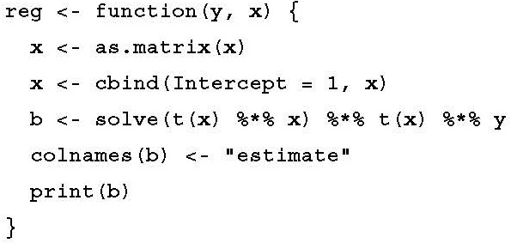
matrix notation
Create a basic regression function named reg()
convert the data frame into matrix form
bind an additional column onto the x matrix
• solve() takes the inverse of a matrix
• t() is used to transpose a matrix
• %*% multiplies two matrices

Slide 22
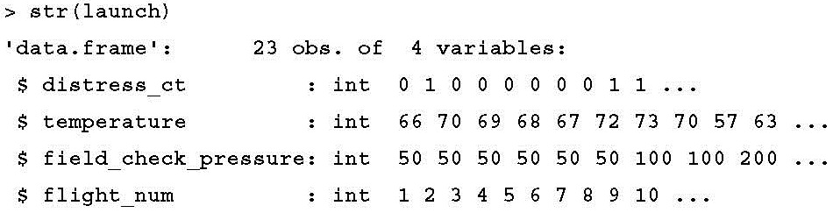
apply our function to the shuttle launch data

Slide 23
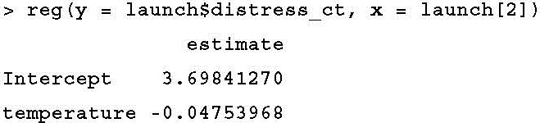
confirm that the function is working correctly
comparing the result to the simple linear regression model of O-ring failures versus temperature, a = 3.70 and b = -0.048

Slide 24
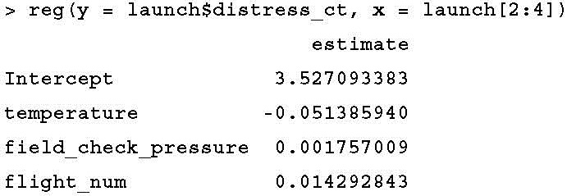
build a multiple regression model

Slide 25
Example – predicting medical expenses using linear regression
Medical expenses are difficult to estimate because the most costly conditions are rare and seemingly random.
some conditions are more prevalent for certain segments of the population.
  E.g., lung cancer is more likely among smokers than non-smokers, and heart disease may be more likely among the obese.
The goal of this analysis is to use patient data to estimate the average medical care expenses for such population segments.
These estimates can be used to create actuarial tables that set the price of yearly premiums higher or lower, depending on the expected treatment costs.

Slide 26
Step 1 – collecting data
a simulated dataset containing hypothetical medical expenses for patients in the United States.
created using demographic statistics from the US Census Bureau, and thus, approximately reflect real-world conditions.
download the insurance.csv file from the Packt Publishing website
  1,338 examples of beneficiaries
  features indicating characteristics of the patient as well as the total medical expenses charged to the plan for the calendar year

Slide 27
The features
age: An integer indicating the age of the primary beneficiary (excluding those above 64 years, since they are generally covered by the government).
sex: The policy holder's gender, either male or female.
bmi: The body mass index (BMI), which provides a sense of how over- or under-weight a person is relative to their height. BMI is equal to weight (in kilograms) divided by height (in meters) squared. An ideal BMI is within the range of 18.5 to 24.9.
children: An integer indicating the number of children/dependents covered by the insurance plan.
smoker: A yes or no categorical variable that indicates whether the insured regularly smokes tobacco.
region: The beneficiary's place of residence in the US, divided into four geographic regions: northeast, southeast, southwest, or northwest.

Slide 28
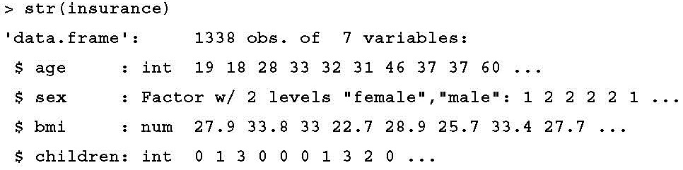

Step 2 – exploring and preparing the data
stringsAsFactors = TRUE because it is appropriate to convert the three nominal variables to factors
> insurance <- read.csv("insurance.csv", stringsAsFactors = TRUE)

Slide 29

normality
dependent variable is expenses
Although linear regression does not strictly require a normally distributed dependent variable, the model often fits better when this is true
the mean value is greater than the median, this implies that the distribution of insurance expenses is right-skewed

Slide 30
histogram
> hist(insurance$expenses)
this distribution is not ideal for a linear regression
knowing this weakness ahead of time may help us design a better-fitting model later on

Slide 31
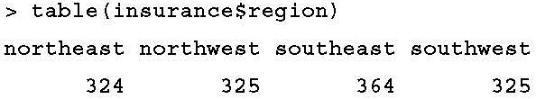
factor-type features
Regression models require that every feature is numeric
three factor-type features in our data frame.
  the sex variable is divided into male and female levels
  smoker is divided into yes and no.
  region variable has four levels

Slide 32
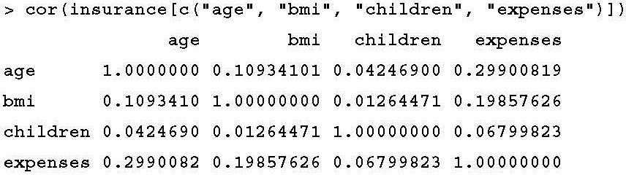
Exploring relationships among features – the correlation matrix
correlation matrix - Given a set of variables, it provides a correlation for each pairwise relationship
cor(x, y) is equal to cor(y, x)

Slide 33
notable associations
age and bmi appear to have a weak positive correlation, meaning that as someone ages, their body mass tends to increase.
There is also a moderate positive correlation between
  age and expenses
  bmi and expenses,
  children and expenses.
  These associations imply that as age, body mass, and number of children increase, the expected cost of insurance goes up

Slide 34
Visualizing relationships among features – the scatterplot matrix
scatterplot matrix (abbreviated as SPLOM), a collection of scatterplots arranged in a grid
provides a general sense of how the data may be interrelated
The pairs() function is provided in a default R installation
> pairs(insurance[c("age", "bmi", "children", "expenses")])

Slide 35
scatterplot matrices
The relationship between age and expenses displays several relatively straight lines
the bmi versus expenses plot has two distinct groups of points

Slide 36
Enhanced scatterplot matrix
pairs.panels() function in the psy package
  install.packages("psych")
  library(psych)
> pairs.panels(insurance[c("age", "bmi", "children", "expenses")])

Slide 37
Above the diagonal, the scatterplots have been replaced with a correlation matrix.
On the diagonal, a histogram depicting the distribution of values for each feature is shown

Slide 38
correlation ellipse
The dot at the center of the ellipse indicates the point at the mean values for the x and y axis variables.
The correlation between the two variables is indicated by the shape of the ellipse
  the more it is stretched, the stronger the correlation
  An almost perfectly round oval indicates a very weak correlation
loess curve - indicates the general relationship between the x and y axis variables
  The curve for age and children is an upside-down U, peaking around middle age - the oldest and youngest people in the sample have fewer children on the insurance plan than those around middle age
  the loess curve for age and bmi is a line sloping gradually up, implying that body mass increases with age

Slide 39
Step 3 – training a model on the data
lm() function - included in the stats package, which should be included and loaded by default

Slide 40
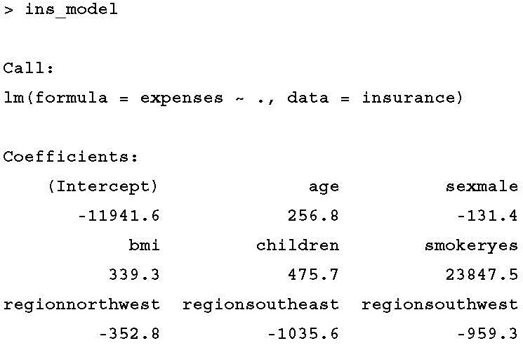
fits a linear regression model
> ins_model <- lm(expenses ~ age + children + bmi + sex + smoker + region, data = insurance)
Or,
> ins_model <- lm(expenses ~ ., data = insurance)
the intercept is of little value alone because it is impossible to have values of zero for all features.
since no person exists with age zero and BMI zero, the intercept has no real-world interpretation
intercept is often ignored

Slide 41
beta coefficients
beta coefficients indicate the estimated increase in expenses for an increase of one in each of the features, assuming all other values are held constant.
  for each additional year of age, we would expect $256.80 higher medical expenses on average
  each additional child results in an average of $475.70 in additional medical expenses each year
  each unit increase in BMI is associated with an average increase of $339.30 in yearly medical expenses

Slide 42
Dummy coding
lm() function automatically applied dummy coding to each of the factor-type variables
Dummy coding allows a nominal feature to be treated as numeric by creating a binary variable, often called a dummy variable, for each category of the feature.
The dummy variable is set to 1 if the observation falls into the specified category or 0 otherwise.
  the sex feature has two categories: male and female. This will be split into two binary variables, which R names sexmale and sexfemale.
    For observations where sex = male, then sexmale = 1 and sexfemale = 0;
    conversely, if sex = female, then sexmale = 0 and sexfemale = 1.
The same coding applies to variables with three or more categories.
  R split the four-category feature region into four dummy variables: regionnorthwest, regionsoutheast, regionsouthwest, and regionnortheast.

Slide 43
reference category
one category is always left out to serve as the reference category.
The estimates are then interpreted relative to the reference.
In our model, R automatically held out the sexfemale, smokerno, and regionnortheast variables, making female non-smokers in the northeast region the reference group.
  males have $131.40 less medical expenses each year relative to females
  smokers cost an average of $23,847.50 more than non-smokers per year.
  The coefficient for each of the three regions in the model is negative, which implies that the reference group, the northeast region, tends to have the highest average expenses
By default, R uses the first level of the factor variable as the reference.
the relevel() function can be used to specify the reference group manually

Slide 44
Step 4 – evaluating model performance
> summary(ins_model)
three key ways to evaluate the performance
1. The residuals

Slide 45
2. p-value, denoted Pr(>|t|)
an estimate of the probability that the true coefficient is zero given the value of the estimate.
Small p-values suggest that the true coefficient is very unlikely to be zero, which means that the feature is extremely unlikely to have no relationship with the dependent variable.
stars (***) indicate the significance level met by the estimate.
  This level is a threshold, chosen prior to building the model
  p-values less than the significance level are considered statistically significant.
  If the model had few such terms, it may be cause for concern, since this would indicate that the features used are not very predictive of the outcome.

Slide 46
3. The multiple R-squared value
also called the coefficient of determination
a measure of how well our model as a whole explains the values of the dependent variable.
It is similar to the correlation coefficient, in that the closer the value is to 1.0, the better the model perfectly explains the data
adjusted R-squared value corrects R-squared by penalizing models with a large number of independent variables.
  useful for comparing the performance of models with different numbers of explanatory variables

Slide 47
Step 5 – improving model performance
if we have subject matter knowledge about how a feature is related to the outcome, we can use this information to inform the model specification and potentially improve the model's performance
Model specification – adding non-linear relationships
  a typical regression equation
  add a higher order term to the regression model
  create a new variable
  > insurance$age2 <- insurance$age^2
    add both age and age2 to the lm() formula using the expenses ~ age + age2 form

Slide 48
Transformation – converting a numeric variable to a binary indicator
Suppose we have a hunch that the effect of a feature is not cumulative, rather it has an effect only after a specific threshold has been reached.
  For instance, BMI may have zero impact on medical expenditures for individuals in the normal weight range, but it may be strongly related to higher costs for the obese (that is, BMI of 30 or above).
  We can model this relationship by creating a binary obesity indicator variable that is 1 if the BMI is at least 30, and 0 if less.
  The estimated beta for this binary feature would then indicate the average net impact on medical expenses for individuals with BMI of 30 or above, relative to those with BMI less than 30.

Slide 49
create the feature
> insurance$bmi30 <- ifelse(insurance$bmi >= 30, 1, 0)
include the bmi30 variable in our improved model
  either replacing the original bmi variable or in addition, depending on whether or not we think the effect of obesity occurs in addition to a separate linear BMI effect
  If you have trouble deciding whether or not to include a variable, a common practice is to include it and examine the p-value

Slide 50
Model specification – adding interaction effects
What if certain features have a combined impact on the dependent variable?
  For instance, smoking and obesity may have harmful effects separately, but it is reasonable to assume that their combined effect may be worse than the sum of each one alone.
When two features have a combined effect, this is known as an interaction.
Interaction effects are specified using the R formula syntax.
  To have the obesity indicator (bmi30) and the smoking indicator (smoker) interact, we would write a formula in the form expenses ~ bmi30*smoker.
  The * operator is shorthand that instructs R to model expenses ~ bmi30 + smokeryes + bmi30:smokeryes.
  The : (colon) operator in the expanded form indicates that bmi30:smokeryes is the interaction between the two variables.
  the expanded form also automatically included the bmi30 and smoker variables as well as the interaction.
Interactions should never be included in a model without also adding each of the interacting variables

Slide 51
Putting it all together – an improved regression model
To summarize the improvements, we:
  Added a non-linear term for age
  Created an indicator for obesity
  Specified an interaction between obesity and smoking
> ins_model2 <- lm(expenses ~ age + age2 + children + bmi + sex + bmi30*smoker + region, data = insurance)
> summary(ins_model2)

Slide 52
improved performance
the R-squared value has improved from 0.75 to about 0.87.
the adjusted R-squared value improved from 0.75 to 0.87
The higher-order age2 term is statistically significant
as is the obesity indicator, bmi30.
The interaction between obesity and smoking suggests a massive effect
  in addition to the increased costs of over $13,404 for smoking alone, obese smokers spend another $19,810 per year

Slide 53
Understanding regression trees and model trees
decision trees can also be used for numeric prediction by making only small adjustments to the tree-growing algorithm
Trees for numeric prediction fall into two categories.
  Regression trees:
    introduced in the 1980s as part of the seminal Classification and Regression Tree (CART) algorithm.
    regression trees do not use linear regression methods
    rather they make predictions based on the average value of examples that reach a leaf
  model trees:
    Introduced several years later than regression trees, they are lesser-known, but perhaps more powerful.
    Model trees are grown in much the same way as regression trees, but at each leaf, a multiple linear regression model is built from the examples reaching that node.
    Depending on the number of leaf nodes, a model tree may build tens or even hundreds of such models. This may make model trees more difficult to understand than the equivalent regression tree, with the benefit that they may result in a more accurate model

Slide 54
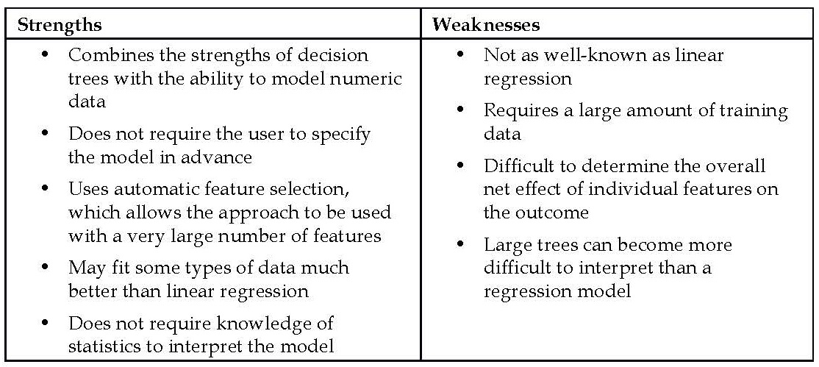
Adding regression to trees
The strengths and weaknesses of regression trees and model trees relative to the more common regression methods

Slide 55
Comparison
traditional regression methods are typically the first choice for numeric prediction tasks
in some cases, numeric decision trees offer distinct advantages.
  decision trees may be better suited for tasks with many features or many complex, non-linear relationships among features and outcome. These situations present challenges for regression.
  Regression modeling also makes assumptions about how numeric data is distributed that are often violated in real-world data. This is not the case for trees

Slide 56
How to build trees for numeric prediction
Trees for numeric prediction are built in much the same way as they are for classification.
  Beginning at the root node, the data is partitioned using a divide-and-conquer strategy according to the feature that will result in the greatest increase in homogeneity in the outcome after a split is performed.
  for numeric decision trees, homogeneity is measured by statistics such as variance, standard deviation, or absolute deviation from the mean.

Slide 57
One common splitting criterion
Standard Deviation Reduction (SDR)
T₁, T₂, ..., T_{n} are the sets of values resulting from a split on a feature
the formula measures the reduction in standard deviation by comparing the standard deviation pre-split to the weighted standard deviation post-split

Slide 58
example
> tee <- c(1, 1, 1, 2, 2, 3, 4, 5, 5, 6, 6, 7, 7, 7, 7)
> at1 <- c(1, 1, 1, 2, 2, 3, 4, 5, 5)
> at2 <- c(6, 6, 7, 7, 7, 7)
> bt1 <- c(1, 1, 1, 2, 2, 3, 4)
> bt2 <- c(5, 5, 6, 6, 7, 7, 7, 7)
> sdr_a <- sd(tee) - (length(at1) / length(tee) * sd(at1) + length(at2) / length(tee) * sd(at2))
> sdr_b <- sd(tee) - (length(bt1) / length(tee) * sd(bt1) + length(bt2) / length(tee) * sd(bt2))
> sdr_a
[1] 1.202815
> sdr_b
[1] 1.392751
Since the standard deviation was reduced more for the split on B, the decision tree would use B first

Slide 59
Prediction
Suppose that the tree stopped growing here using this one and only split. A regression tree's work is done.
It can make predictions for new examples depending on whether the example's value on feature B places the example into group T1 or T2.
If the example ends up in T1, the model would predict mean(bt1) = 2,
otherwise it would predict mean(bt2) = 6.25.
a model tree would go one step further.
Using the seven training examples falling in group T1 and the eight in T2,
the model tree could build a linear regression model of the outcome versus feature A.
The model tree can then make predictions for new examples using either of the two linear models.

Slide 60
Example – estimating the quality of wines with regression trees and model trees
there are numerous factors that contribute to the profitability of a winery
the winemaking industry has heavily invested in data collection and machine learning methods that may assist with the decision science of winemaking
More recently, machine learning has been employed to assist with rating the quality of wine—a notoriously difficult task
In this case study, we will use regression trees and model trees to create a system capable of mimicking expert ratings of wine
  trees result in a model that is readily understood
  the system does not suffer from the human elements of tasting

Slide 61
Step 1 – collecting data
data donated to the UCI Machine Learning Data Repository (http://archive.ics.uci.edu/ml) by P. Cortez, A. Cerdeira, F. Almeida, T. Matos, and J. Reis.
The data include examples of red and white Vinho Verde wines from Portugal—one of the world's leading wine-producing countries.
for this analysis we will examine only the more popular white wines
download the whitewines.csv file from the Packt Publishing website

Slide 62
The challenge
11 chemical properties
4,898 wine samples.
For each wine, a laboratory analysis measured characteristics such as acidity, sugar content, chlorides, sulfur, alcohol, pH, and density.
The samples were then rated in a quality scale ranging from zero (very bad) to 10 (excellent).
The study by Cortez evaluated the ability of three machine learning approaches to model the wine data:
  multiple regression
  artificial neural networks
  Support vector machines - offered significantly better results, but difficult to interpret
Using regression trees and model trees, we may be able to improve the regression results while still having a model that is easy to understand

Slide 63
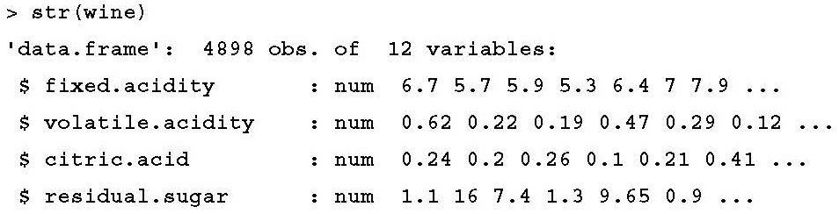
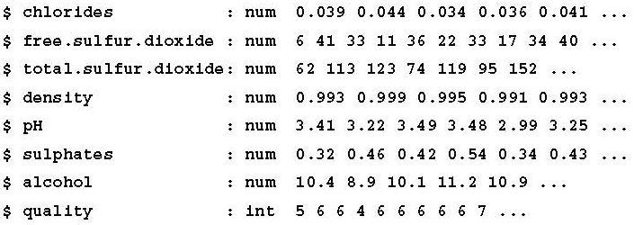
Step 2 – exploring and preparing the data
all of the features are numeric, we can safely ignore the stringsAsFactors parameter:
> wine <- read.csv("whitewines.csv")

Slide 64
distribution of the outcome variable
one of the advantages of trees is that they can handle many types of data without preprocessing.
This means we do not need to normalize or standardize the features.
examine the distribution of quality using a histogram:
> hist(wine$quality)

Slide 65
distribution of quality

Slide 66
last step
divide into training and testing datasets
Wine data set was already sorted into random order, we can partition into two sets of contiguous rows as follows:
> wine_train <- wine[1:3750, ]
> wine_test <- wine[3751:4898, ]
In order to mirror the conditions used by Cortez, we used sets of 75 percent and 25 percent for training and testing, respectively.

Slide 67
Step 3 – training a model on the data
the rpart (recursive partitioning) package offers the most faithful implementation of regression trees as they were described by the CART team.
As the classic R implementation of CART, the rpart package is also well-documented and supported with functions for visualizing and evaluating the rpart models.
> install.packages("rpart")
> library(rpart)

Slide 68
syntax

Slide 69
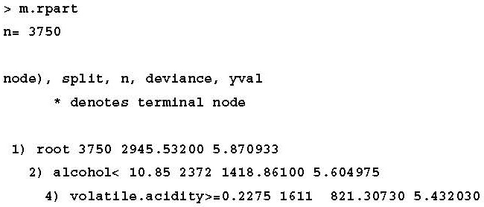
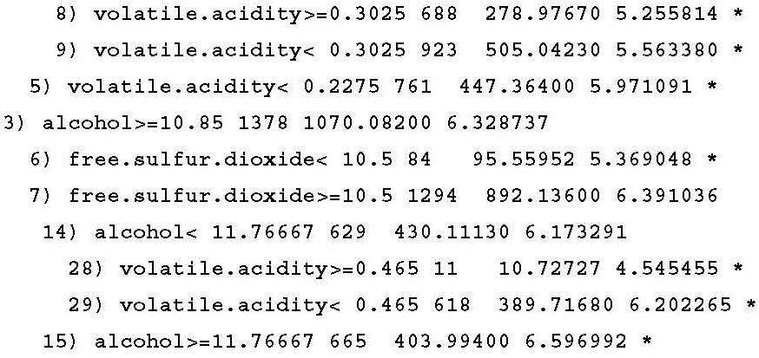
Modeling
> m.rpart <- rpart(quality ~ ., data = wine_train)
For each node in the tree, the number of examples reaching the decision point is listed
3,750 examples begin at the root node
2,372 have alcohol < 10.85
Nodes indicated by * are terminal or leaf nodes, which means that they result in a prediction (listed here as yval)

Slide 70
Visualizing decision trees
The rpart.plot package by Stephen Milborrow provides an easy-to-use function that produces publication-quality decision trees.
author's website at http://www.milbo.org/rpart-plot/
> install.packages("rpart.plot")
> library(rpart.plot)
> rpart.plot(m.rpart, digits = 3)

Slide 71
tree diagram

Slide 72
a few of the useful options
> rpart.plot(m.rpart, digits = 4, fallen.leaves = TRUE, type = 3, extra = 101)

Slide 73
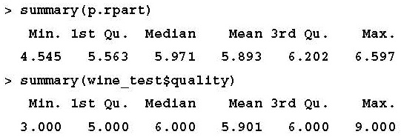
Step 4 – evaluating model performance
> p.rpart <- predict(m.rpart, wine_test)
a potential problem –
  the predictions fall on a much narrower range than the true values
  the model is not correctly identifying the extreme cases, in particular the best and worst wines

Slide 74
correlation between the predicted and actual quality values
compare how well the predicted values correspond to the true values:
> cor(p.rpart, wine_test$quality)
[1] 0.5369525
A correlation of 0.54 is certainly acceptable.
the correlation only measures how strongly the predictions are related to the true value;
it is not a measure of how far off the predictions were from the true values.

Slide 75
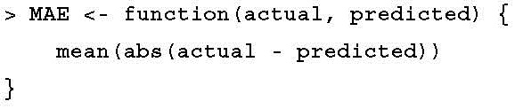
Measuring performance with the mean absolute error
mean absolute error (MAE) - how far, on average, the model’s prediction was from the true value
n indicates the number of predictions and e_{i} indicates the error for prediction i.
a simple MAE() function:

Slide 76
The MAE for our predictions
> MAE(p.rpart, wine_test$quality)
[1] 0.5872652
This implies that, on average, the difference between our model's predictions and the true quality score was about 0.59
The mean quality rating in the training data is as follows:
> mean(wine_train$quality)
[1] 5.870933
If we predicted the value 5.87 for every wine sample, we would have a mean absolute error of only about 0.67:
> MAE(5.87, wine_test$quality)
[1] 0.6722474
Our regression tree (MAE = 0.59) comes closer on average to the true quality score than the imputed mean (MAE = 0.67), but not by much.
In comparison, Cortez reported an MAE of 0.58 for the neural network model and an MAE of 0.45 for the support vector machine.
This suggests that there is room for improvement.

Slide 77
Step 5 – improving model performance
The current state-of-the-art in model trees is the M5' algorithm (M5-prime)
  by Y. Wang and I.H. Witten
  a variant of the original M5 model tree algorithm proposed by J.R. Quinlan in 1992
  The M5 algorithm is available in R via the RWeka package

Slide 78
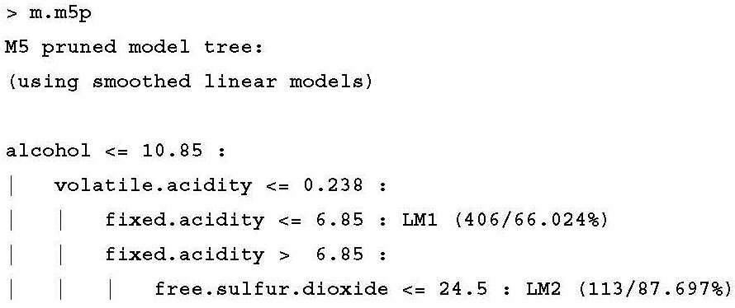
fit the model tree
> library(RWeka)
> m.m5p <- M5P(quality ~ ., data = wine_train)
the nodes terminate not in a numeric prediction, but a linear model (shown here as LM1 and LM2).

Slide 79
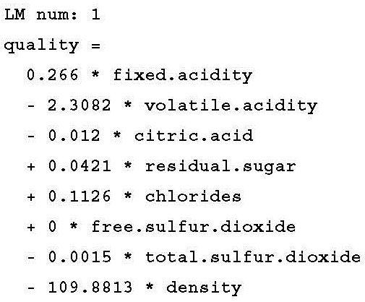
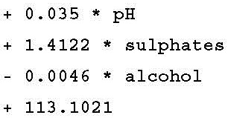
The linear models

Slide 80
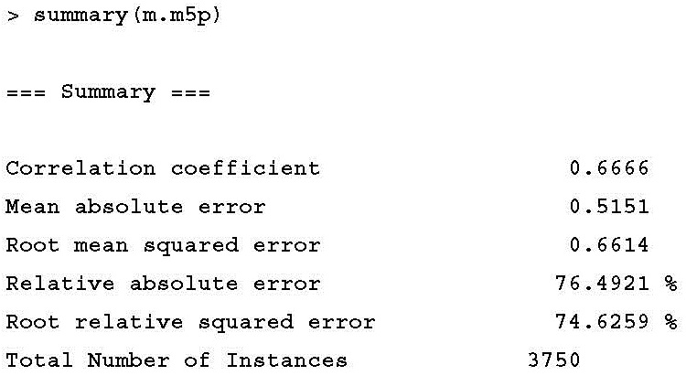
how well the model fits the training data
statistics are based on the training data, they should be used only as a rough diagnostic:

Slide 81
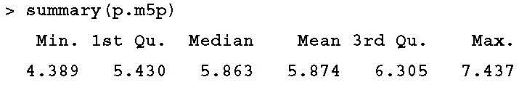
how well the model performs on the unseen test data
> p.m5p <- predict(m.m5p, wine_test)
The model tree appears to be predicting a wider range of values than the regression tree:
The correlation also seems to be substantially higher:
> cor(p.m5p, wine_test$quality)
[1] 0.6272973
Furthermore, the model has slightly reduced the mean absolute error:
> MAE(wine_test$quality, p.m5p)
[1] 0.5463023
Although we did not improve a great deal beyond the regression tree, we surpassed the performance of the neural network model published by Cortez

Slide 82
The End of Chapter 6

