Slide 1
Chapter 5
Divide and Conquer – Classification Using Decision Trees and Rules

Slide 2
decision trees and rule learners
two machine learning methods that make complex decisions from sets of simple choices
  present their knowledge in the form of logical structures
  particularly useful for business strategy and process improvement
Objectives
  How trees and rules "greedily" partition data into interesting segments
  The most common decision tree and classification rule learners, including the C5.0, 1R, and RIPPER algorithms
  How to use these algorithms to perform real-world classification tasks, such as identifying risky bank loans and poisonous mushrooms

Slide 3
Understanding decision trees
tree structure to model the relationships among the features and the potential outcomes
  branching decisions, which channel examples into a final predicted class value
E.g.,
Root node
Decision nodes – split the data across branches
Leaf nodes (terminal nodes – the action to be taken or expected results

Slide 4
benefit of decision tree algorithms
flowchart-like tree structure
  Not necessarily exclusively for the learner's internal use
  in a human-readable format
  provides insight into how and why the model works or doesn't work
  classification mechanism can be transparent
some potential uses
  Credit scoring models in which the criteria that causes an applicant to be rejected need to be clearly documented and free from bias
  Marketing studies of customer behavior such as satisfaction or churn, which will be shared with management or advertising agencies
  Diagnosis of medical conditions based on laboratory measurements, symptoms, or the rate of disease progression

Slide 5
Pros and cons
Pros
  decision trees are perhaps the single most widely used machine learning technique
  can be applied to model almost any type of data
Cons
  trees may not be an ideal fit for a task where the data has a large number of nominal features with many levels or it has a large number of numeric features.
    result in a very large number of decisions and an overly complex tree.
    tendency of decision trees to overfit data

Slide 6
Divide and conquer
recursive partitioning
  splits the data into subsets, which are then split repeatedly into even smaller subsets, …
  stops when the algorithm determines the data within the subsets are sufficiently homogenous, or another stopping criterion has been met
Steps
  the root node represents the entire dataset
  choose a feature to split upon; ideally, it chooses the feature most predictive of the target class.
  The examples are then partitioned into groups according to the distinct values of this feature
  stop at a node in a case that:
    All (or nearly all) of the examples at the node have the same class
    There are no remaining features to distinguish among the examples
    The tree has grown to a predefined size limit

Slide 7
Example - Hollywood studio
predict whether a potential movie would fall into one of three categories: Critical Success, Mainstream Hit, or Box Office Bust
the factors leading to the success and failure of the company's 30 most recent releases

Slide 8
build a decision tree
split the feature indicating the number of celebrities

Slide 9
build a decision tree cont’d
another split between movies with and without a high budget

Slide 10
build a decision tree cont’d
partitioned the data into three groups.
  top-left corner: entirely of critically acclaimed films.
    high number of celebrities and a relatively low budget.
  top-right corner: box office hits with high budgets and a large number of celebrities.
  final group: little star power but budgets ranging from small to large
could continue to divide and conquer the data by splitting it based on the increasingly specific ranges of budget and celebrity count
not advisable to overfit a decision tree

Slide 11
axis-parallel splits
The fact that each split considers one feature at a time prevents the decision tree from forming more complex decision boundaries
  a diagonal line could be created by a decision that asks, "is the number of celebrities is greater than the estimated budget?" If so, then "it will be a critical success."

Slide 12
The C5.0 decision tree algorithm
C5.0 algorithm
  Developed by computer scientist J. Ross Quinlan
  Iterative Dichotomiser 3 (ID3) -> C4.5 -> C5.0
  http://www.rulequest.com/
  single-threaded version publically available
  industry standard to produce decision trees
J48 - Java-based open source alternative to C4.5

Slide 13
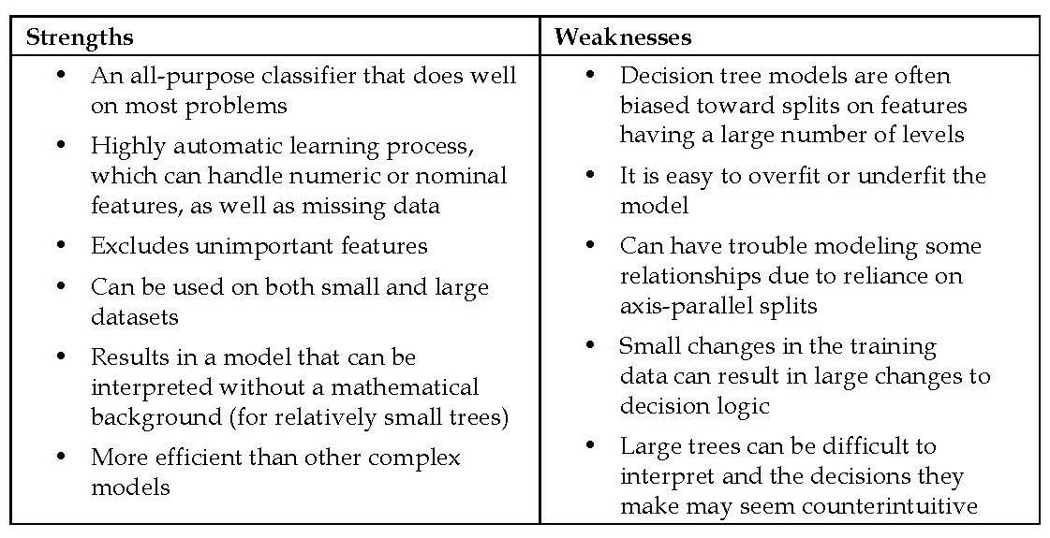
Pros and cons

Slide 14
Choosing the best split
first challenge - identify which feature to split upon
  split the data such that the resulting partitions contained examples primarily of a single class
purity - degree to which a subset of examples contains only a single class
  Any subset composed of only a single class is called pure
Entropy - concept borrowed from information theory that quantifies the randomness, or disorder
  measurements of purity
  Sets with high entropy are very diverse

Slide 15
entropy
If there are only two possible classes, entropy values can range from 0 to 1.
For n classes, entropy ranges from 0 to log2(n).
the minimum value indicates that the sample is completely homogenous
the maximum value indicates that the data are as diverse as possible

Slide 16
mathematical notion
S - given segment of data
c - the number of class levels
p_{i} - the proportion of values falling into class level i.
E.g., partition of data with two classes: red (60 percent) and white (40 percent)
> -0.60 * log2(0.60) - 0.40 * log2(0.40)
[1] 0.9709506

Slide 17
entropy for all the possible two-class arrangements
Using the curve() function, plot the entropy for all the possible values of x:
> curve(-x * log2(x) - (1 - x) * log2(1 - x), col = "red", xlab = "x", ylab = "Entropy", lwd = 4)
50-50 split results in maximum entropy.
As one class increasingly dominates the other, the entropy reduces to zero

Slide 18
determine the optimal feature to split upon
information gain - the change in homogeneity that would result from a split on each possible feature
information gain for a feature F - the difference between the entropy in the segment before the split (S₁) and the partitions resulting from the split (S₂):
function to calculate Entropy(S₂) needs to consider the total entropy across all of the partitions
  weighing each partition's entropy by the proportion of records falling into the partition
  the total entropy resulting from a split is the sum of the entropy of each of the n partitions weighted by the proportion of examples falling in the partition (wi).

Slide 19
information gain
The higher the information gain, the better a feature is at creating homogeneous groups after a split on this feature.
If the information gain is zero, there is no reduction in entropy for splitting on this feature.
the maximum information gain is equal to the entropy prior to the split, which means that the split results in completely homogeneous groups

Slide 20
splitting on numeric features
Test various splits that divide the values into groups greater than or less than a numeric threshold
reduces the numeric feature into a two-level categorical feature
The numeric cut point yielding the largest information gain is chosen for the split

Slide 21
Pruning the decision tree
A decision tree can continue to grow indefinitely
if the tree grows overly large, many of the decisions it makes will be overly specific and the model will be overfitted to the training data
pruning a decision tree - reducing its size such that it generalizes better to unseen data
One solution - early stopping or pre-pruning the decision tree: stop the tree from growing once it reaches a certain number of decisions or when the decision nodes contain only a small number of examples
  there is no way to know whether the tree will miss subtle, but important patterns that it would have learned had it grown to a larger size

Slide 22
post-pruning
growing a tree that is intentionally too large and pruning leaf nodes to reduce the size of the tree to a more appropriate level
often a more effective approach than pre-pruning
  it is quite difficult to determine the optimal depth of a decision tree without growing it first.
  Pruning the tree later on allows the algorithm to be certain that all the important data structures were discovered
subtree raising and subtree replacement
  first grows a large tree that overfits the training data.
  Later, the nodes and branches that have little effect on the classification are removed.
  In some cases, entire branches are moved further up the tree or replaced by simpler decisions

Slide 23
Example – identifying risky bank loans using C5.0 decision trees
Decision trees are widely used in the banking industry due to their high accuracy and ability to formulate a statistical model in plain language
we will develop a simple credit approval model using C5.0 decision trees
Step 1 – collecting data
  to identify factors that are predictive of higher risk of default.
  need to obtain data on a large number of past bank loans and whether the loan went into default, as well as information on the applicant

Slide 24
The dataset
dataset donated to the UCI Machine Learning Data Repository (http://archive.ics.uci.edu/ml)
  by Hans Hofmann of the University of Hamburg.
  The dataset contains information on loans obtained from a credit agency in Germany
  Preprocessed version: download the credit.csv file from Packt Publishing's website
Characteristics
  1,000 examples on loans
  a set of numeric and nominal features indicating the characteristics of the loan and the loan applicant.
  A class variable indicates whether the loan went into default

Slide 25
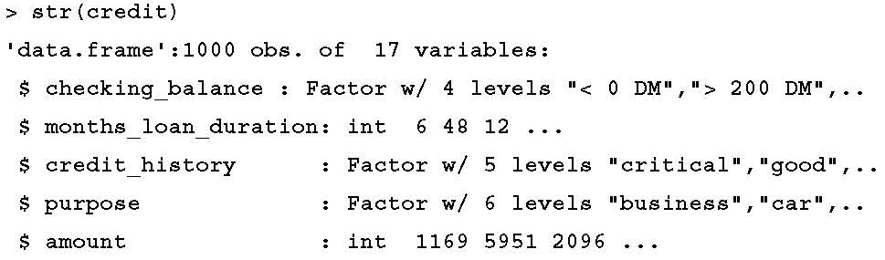

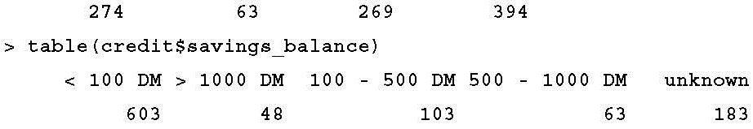
Step 2 – exploring and preparing the data
> credit <- read.csv("credit.csv")

Slide 26
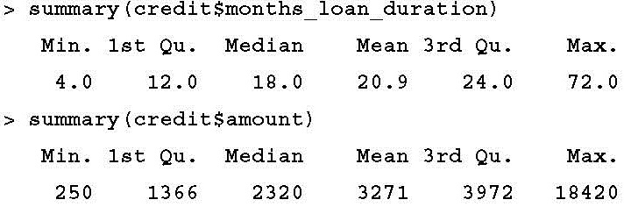
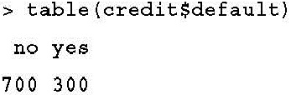
Numeric features and default rate

Slide 27
Data preparation – creating random training and test datasets
split our data into two portions:
  a training dataset – 90% (900 records)
  a test dataset – 10% (100 records)
the credit dataset is not randomly ordered
random sample - sample() function
  common practice is to set a seed value, which causes the randomization process to follow a sequence that can be replicated later on if desired
  set.seed() function
  pseudorandom number generator

Slide 28
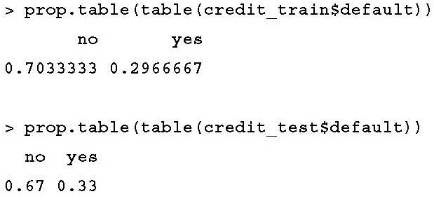
The commands
> set.seed(123)
> train_sample <- sample(1000, 900)
> str(train_sample)
int [1:900] 288 788 409 881 937 46 525 887 548 453 ...
> credit_train <- credit[train_sample, ]
> credit_test <- credit[-train_sample, ]

Slide 29
Step 3 – training a model on the data
use the C5.0 algorithm in the C50 package
  > install.packages("C50")
  > library(C50)
?C5.0 Control command displays the help page

Slide 30
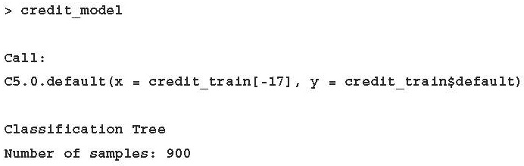
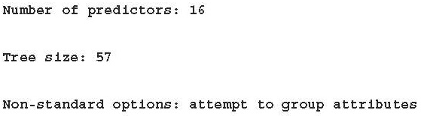
use the default C5.0 configuration
> credit_model <- C5.0(credit_train[-17], credit_train$default)

Slide 31
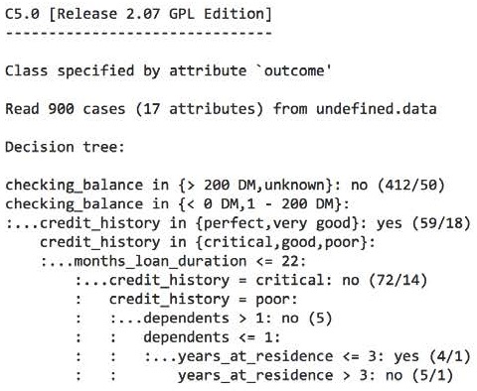
see the tree's decisions
The first three lines could be represented in plain language as:
1. If the checking account balance is unknown or greater than 200 DM, then classify as "not likely to default."
2. Otherwise, if the checking account balance is less than zero DM or between one and 200 DM.
3. And the credit history is perfect or very good, then classify as "likely to default."
> summary(credit_model)
The numbers in parentheses indicate the number of examples meeting the criteria for that decision, and the number incorrectly classified by the decision.
- e.g., On the first line, 412/50 indicates that of the 412 examples reaching the decision, 50 were incorrectly classified as not likely to default
Sometimes a tree results in decisions that make little logical sense.
e.g., why would an applicant whose credit history is very good be likely to default?

Slide 32
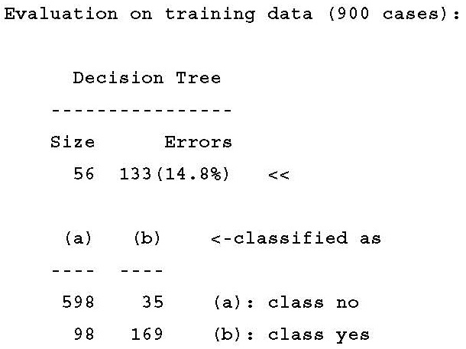
confusion matrix
summary(credit_model)
model correctly classified all but 133 of the 900 training instances for an error rate of 14.8 percent.
A total of 35 actual no values were incorrectly classified as yes (false positives)
98 yes values were misclassified as no (false negatives)

Slide 33
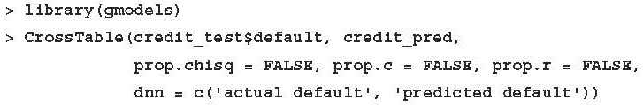
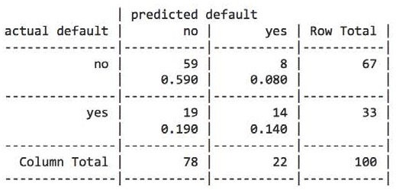
Step 4 – evaluating model performance
> credit_pred <- predict(credit_model, credit_test)
accuracy of 73 percent and an error rate of 27 percent
the model only correctly predicted 14 of the 33 actual loan defaults in the test data, or 42 percent

Slide 34
Step 5 – improving model performance
Our model's error rate is likely to be too high
  if the model had predicted "no default" for every test case, it would have been correct 67 percent of the time
  our model performed especially poorly at identifying applicants who do default on their loans
Boosting the accuracy of decision trees
  adaptive boosting – a process in which many decision trees are built and the trees vote on the best class for each example
  research by Rob Schapire and Yoav Freund
  rooted in the notion that by combining a number of weak performing learners, you can create a team that is much stronger than any of the learners alone

Slide 35
The trials parameter
the number of separate decision trees to use in the boosted team
The trials parameter sets an upper limit
the algorithm will stop adding trees if it recognizes that additional trials do not seem to be improving the accuracy
10 trials - a number that has become the de facto standard, as research suggests that this reduces error rates on test data by about 25 percent
> credit_boost10 <- C5.0(credit_train[-17], credit_train$default, trials = 10)
> credit_boost10
Number of boosting iterations: 10
Average tree size: 47.5

Slide 36
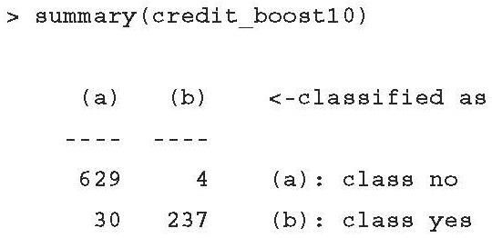
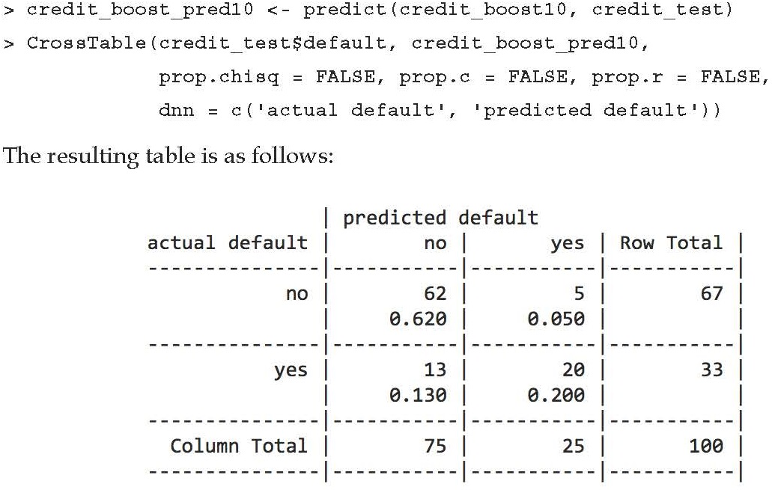
the model's performance
The classifier made 34 mistakes on 900 training examples for an error rate of 3.8 percent
Total error rate 27% -> 18% (> 25% reduction)
still not doing well at predicting defaults, predicting only 20/33 = 61% correctly

Slide 37
Making mistakes more costlier than others
One solution to reduce the number of false negatives may be to reject a larger number of borderline applicants
the interest the bank would earn from a risky loan is far outweighed by the massive loss it would incur if the money is not paid back at all
C5.0 - Assign a penalty to different types of errors
cost matrix - specifies how much costlier each error is, relative to any other prediction
> matrix_dimensions <- list(c("no", "yes"), c("no", "yes"))
> names(matrix_dimensions) <- c("predicted", "actual")
> matrix_dimensions
$predicted
[1] "no" "yes"
$actual
[1] "no" "yes"
R fills a matrix by filling columns one by one from top to bottom:
• Predicted no, actual no
• Predicted yes, actual no
• Predicted no, actual yes
• Predicted yes, actual yes

Slide 38
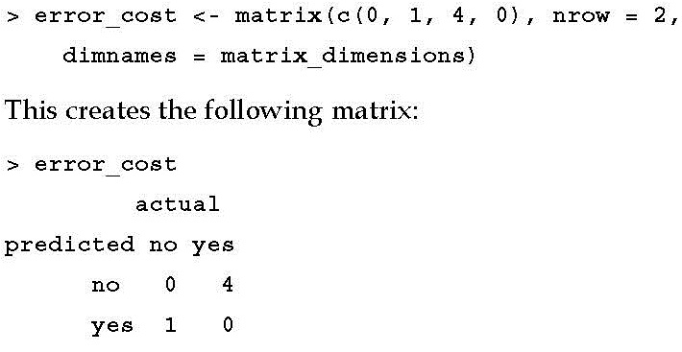
penalty values
we believe that a loan default costs the bank four times as much as a missed opportunity

Slide 39
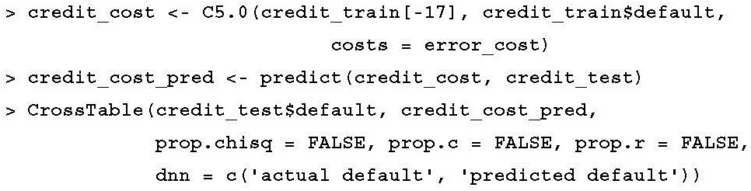
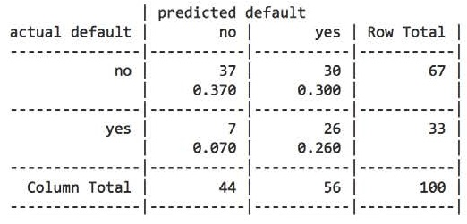
The result
more mistakes overall: 37%
79% of the actual defaults were predicted to be defaults
reduction of false negatives at the expense of increasing false positives

Slide 40
Understanding classification rules
Classification rules represent knowledge in the form of logical if-else statements that assign a class to unlabeled examples
Antecedent - comprises certain combinations of feature values
Consequent - specifies the class value to assign when the rule's conditions are met
Rule learners can be used for applications that generate knowledge for future action, such as:
  • Identifying conditions that lead to a hardware failure in mechanical devices
  • Describing the key characteristics of groups of people for customer segmentation
  • Finding conditions that precede large drops or increases in the prices of shares on the stock market

Slide 41
some distinct advantages
Tree - must be applied from top-to-bottom through a series of decisions
rules - propositions that can be read much like a statement of fact
decision trees bring a particular set of biases to the task
rule learner avoids by identifying the rules directly
Rule learners are generally applied to problems where the features are primarily or entirely nominal.
They do well at identifying rare events, even if the rare event occurs only for a very specific interaction among feature values

Slide 42
Separate and conquer
The process involves
  identifying a rule that covers a subset of examples in the training data
  separating this partition from the remaining data
  As the rules are added, additional subsets of the data are separated
  Until the entire dataset has been covered and no more examples remain
drilling down into the data by creating increasingly specific rules to identify class values

Slide 43
identify whether or not an animal is a mammal
set of all animals
using the available features to find homogeneous groups
  first rule might suggest that any land-based animals are mammals

Slide 44
frogs are amphibians, not mammals
drill down further by suggesting that mammals must walk on land and have a tail

Slide 45
distinguishing bats from the other remaining animals
A potential feature - presence of fur

Slide 46
the rule learning process stops
a total of three rules:
  Animals that walk on land and have tails are mammals
  If the animal does not have fur, it is not a mammal
  Otherwise, the animal is a mammal
separate and conquer algorithms are also known as covering algorithms
  resulting rules are called covering rules

Slide 47
The 1R algorithm
ZeroR - a rule learner that literally learns no rules.
  For every unlabeled example, regardless of the values of its features, it predicts the most common class
The 1R algorithm (One Rule or OneR) - selecting a single rule
  it tends to perform better than you might expect
  As demonstrated in empirical studies, the accuracy of this algorithm can approach that of much more sophisticated algorithms for many real-world tasks

Slide 48
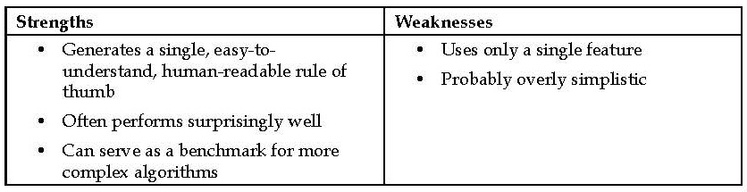
strengths and weaknesses of the 1R algorithm

Slide 49
The way 1R works
For each feature
  1R divides the data into groups based on similar values of the feature.
  Then, for each segment, the algorithm predicts the majority class.
  The error rate for the rule based on each feature is calculated and the rule with the fewest errors is chosen as the one rule

Slide 50
how 1R works for the animal data

Slide 51
the single most important rule
"one rule" based on Travels By:
If the animal travels by air, it is not a mammal
If the animal travels by land, it is a mammal
If the animal travels by sea, it is not a mammal

Slide 52
The RIPPER algorithm
Early rule learning algorithms were plagued by a couple of problems
  First, they were notorious for being slow, which made them ineffective for the increasing number of large datasets.
  Secondly, they were often prone to being inaccurate on noisy data.
Incremental Reduced Error Pruning (IREP)
  proposed in 1994 by Johannes Furnkranz and Gerhard Widmer
  uses a combination of pre-pruning and post-pruning methods that grow very complex rules and prune them before separating the instances from the full dataset.
  Although this strategy helped the performance of rule learners, decision trees often still performed better

Slide 53
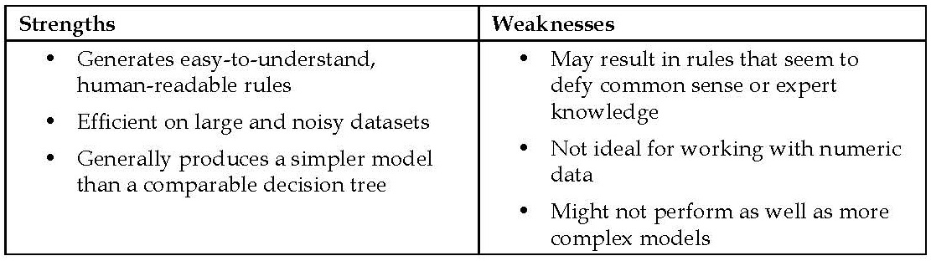
Repeated Incremental Pruning to Produce Error Reduction (RIPPER)
1995 William W. Cohen
improved upon IREP to generate rules that match or exceed the performance of decision trees
strengths and weaknesses of RIPPER

Slide 54
the RIPPER algorithm
a patchwork of efficient heuristics for rule learning
three-step process:
Grow: uses the separate and conquer technique to greedily add conditions to a rule until it perfectly classifies a subset of data or runs out of attributes for splitting
  the information gain criterion is used to identify the next splitting attribute
2. Prune: the information gain criterion is used to identify the next splitting attribute.
  When increasing a rule's specificity no longer reduces entropy, the rule is immediately pruned.
  Steps one and two are repeated until it reaches a stopping criterion
3. Optimize

Slide 55
Pros and cons
The RIPPER algorithm can create much more complex rules than can the 1R algorithm, as it can consider more than one feature
  E.g., "if an animal flies and has fur, then it is a mammal
rules can quickly become more difficult to comprehend
New rule learning algorithms: IREP++, SLIPPER, TRIPPER, etc.

Slide 56
Rules from decision trees
Beginning at a leaf node and following the branches back to the root, you will have obtained a series of decisions. These can be combined into a single rule

Slide 57
predict movie success
Following the paths from the root node down to each leaf, the rules would be:
  1. If the number of celebrities is low, then the movie will be a Box Office Bust.
  2. If the number of celebrities is high and the budget is high, then the movie will be a Mainstream Hit.
  3. If the number of celebrities is high and the budget is low, then the movie will be a Critical Success.
Con: the resulting rules are often more complex than those learned by a rule learning algorithm
Pro: it is sometimes more computationally efficient to generate rules from trees

Slide 58
What makes trees and rules greedy?
greedy learners - use data on a first-come, first-served basis
  make partitions one at a time, finding the most homogeneous partition first, followed by the next best, and so on, until all examples have been classified
greedy algorithms are not guaranteed to generate the optimal, most accurate, or smallest number of rules
  greedy learner may quickly find a single rule that is accurate for one subset of data;
  the learner may miss the opportunity to develop a more nuanced set of rules with better overall accuracy on the entire set of data.
without using the greedy approach to rule learning, it is likely that for all but the smallest of datasets, rule learning would be computationally infeasible

Slide 59
computational feasibility

Slide 60
Subtle differences
once divide and conquer splits on a feature, the partitions created by the split may not be re-conquered, only further subdivided.
  a tree is permanently limited by its history of past decisions.
decision tree:
  If an animal walks on land and has fur, then it is a mammal (bears, cats, dogs, elephants, pigs, rabbits, rats, rhinos)
  If an animal walks on land and does not have fur, then it is not a mammal (frogs)
  If the animal does not walk on land and has fur, then it is a mammal (bats)
  If the animal does not walk on land and does not have fur, then it is not a mammal (birds, insects, sharks, fish, eels)
once separate and conquer finds a rule, any examples not covered by all of the rule's conditions may be re-conquered.
The rule learner:
  Animals that walk on land and have tails are mammals (bears, cats, dogs, elephants, pigs, rabbits, rats, rhinos)
  If the animal does not has fur, it is not a mammal (birds, eels, fish, frogs, insects, sharks)
  Otherwise, the animal is a mammal (bats)

Slide 61
Rule learner
Note how frog was classified

Slide 62
Comparison
rule learners often find a more parsimonious set of rules than those generated from decision trees.
the computational cost of rule learners may be somewhat higher than for decision trees - reuse of data

Slide 63
Example – identifying poisonous mushrooms with rule learners
there are no clear rules to identify whether a wild mushroom is poisonous or edible
Step 1 – collecting data
  Mushroom dataset by Jeff Schlimmer of Carnegie Mellon University.
  The raw dataset is available freely at the UCI Machine Learning Repository (http://archive.ics.uci.edu/ml)
  The dataset includes information on 8,124 mushroom samples from 23 species of gilled mushrooms listed in Audubon Society Field Guide to North American Mushrooms (1981).
  22 features of the mushroom samples, including characteristics such as cap shape, cap color, odor, gill size and color, stalk shape, and habitat
  Download the mushrooms.csv file from the Packt Publishing website

Slide 64
Step 2 – exploring and preparing the data
> mushrooms <- read.csv("mushrooms.csv", stringsAsFactors = TRUE)
The output of the str(mushrooms) include:
$ veil_type : Factor w/ 1 level "partial": 1 1 1 1 1 1 ...
since the veil type does not vary across samples, it does not provide any useful information for prediction
> mushrooms$veil_type <- NULL
By assigning NULL to the veil type vector, R eliminates the feature from the mushrooms data frame

Slide 65
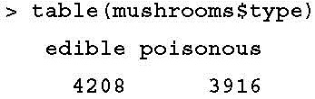
distribution of the mushroom type class variable
About 52 percent of the mushroom samples (N = 4,208) are edible, while 48 percent (N = 3,916) are poisonous
we do not need to hold some samples out of the training data for testing purposes. We are not trying to develop rules that cover unforeseen types of mushrooms; we are merely trying to find rules that accurately depict the complete set of known mushroom types. Therefore, we can build and test the model on the same data

Slide 66
Step 3 – training a model on the data
ZeroR ignores all of the features and simply predicts the target's mode
  its rule would state that all the mushrooms are edible
use the 1R implementation in the RWeka package called OneR()
  install.packages("RWeka")
  library(RWeka)

Slide 67
Syntax
R formula syntax –
The class variable to be
learned goes to the left of the tilde, and the predictor features are written on the right,
separated by + operators
e.g., y ~ x1 + x2
y ~ .

Slide 68
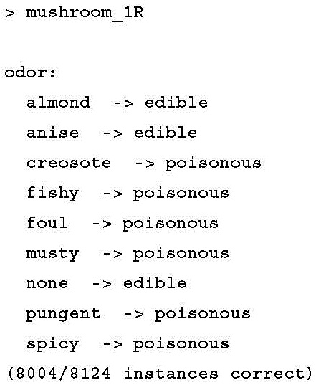
constructing the rules to predict type
> mushroom_1R <- OneR(type ~ ., data = mushrooms)
these rules could be summarized in a simple rule of thumb: "if the mushroom smells unappetizing, then it is likely to be poisonous."

Slide 69
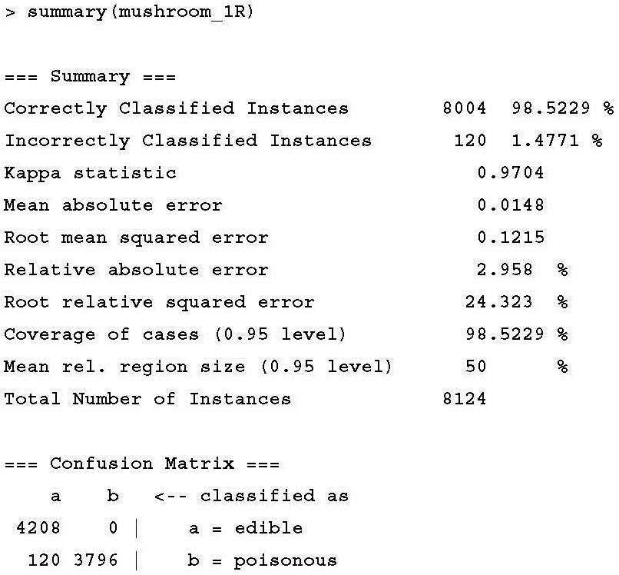
Step 4 – evaluating model performance
a = edible and b = poisonous
1R classifier did not classify any edible mushrooms as poisonous
it did classify 120 poisonous mushrooms as edible

Slide 70
Step 5 – improving model performance
JRip(), a Java-based implementation of the RIPPER rule learning algorithm
included in the RWeka package

Slide 71
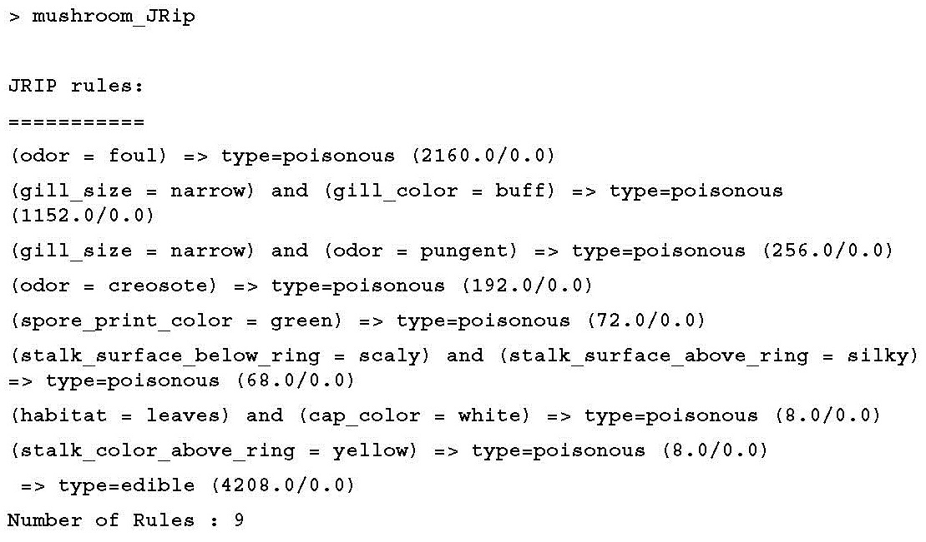
train the JRip() rule learner
> mushroom_JRip <- JRip(type ~ ., data = mushrooms)

Slide 72
nine rules
The first three rules could be expressed as:
  If the odor is foul, then the mushroom type is poisonous
  If the gill size is narrow and the gill color is buff, then the mushroom type is poisonous
  If the gill size is narrow and the odor is pungent, then the mushroom type is poisonous
the ninth rule implies that any mushroom sample that was not covered by the preceding eight rules is edible
  Else, the mushroom is edible
The numbers next to each rule indicate the number of instances covered by the rule and a count of misclassified instances

Slide 73
how the rules are applied to the mushroom data

Slide 74
The End of Chapter 5

