Slide 1
Chapter 4
Probabilistic Learning – Classification Using Naïve Bayes

Slide 2
probabilistic methods
use data on past events to extrapolate future events
  E.g., the chance of rain describes the proportion of prior days to similar measurable atmospheric conditions in which precipitation occurred
Topics of the chapter
  Basic principles of probability
  The specialized methods and data structures needed to analyze text data with R
  How to employ Naive Bayes to build an SMS junk message filter

Slide 3
Understanding Naive Bayes
technique descended from the work of the 18th century mathematician Thomas Bayes
Bayesian methods - foundational principles to describe the probability of events
probability is a number between 0 and 1 (that is, between 0 percent and 100 percent)
The idea:
  utilize training data to calculate an observed probability of each outcome based on the evidence provided by feature values
  When the classifier is later applied to unlabeled data, it uses the observed probabilities to predict the most likely class for the new features

Slide 4
Suitable areas
Success in:
  Text classification, such as junk e-mail (spam) filtering
  Intrusion or anomaly detection in computer networks
  Diagnosing medical conditions given a set of observed symptoms
best applied to problems in which the information from numerous attributes should be considered simultaneously in order to estimate the overall probability of an outcome
Bayesian methods utilize all the available evidence to subtly change the predictions

Slide 5
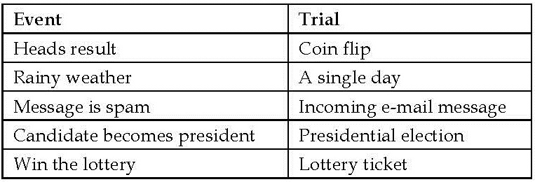
Basic concepts of Bayesian methods
Bayesian probability theory is rooted in the idea that the estimated likelihood of an event, or a potential outcome, should be based on the evidence at hand across multiple trials, or opportunities for the event to occur.
Event and trial

Slide 6
Understanding probability
The probability of an event is estimated from the observed data by dividing the number of trials in which the event occurred by the total number of trials
  E.g., if it rained 3 out of 10 days with similar conditions as today, the probability of rain today can be estimated as 3 / 10 = 0.30 - P(rain) = 0.30
  E.g., if 10 out of 50 prior email messages were spam, then the probability of any incoming message being spam can be estimated as 10 / 50 = 0.20 - P(spam) = 0.20
The probability of all the possible outcomes of a trial must always sum to 1 - mutually exclusive and exhaustive events

Slide 7
complement
Complement (A^{c} or A‘) - the event comprising of the outcomes in which the event of interest (A) does not happen
P(¬A) = P(A^{c})
P(spam) and P(¬spam)

Slide 8
Understanding joint probability
monitoring several nonmutually exclusive events for the same trial
If certain events occur with the event of interest, we may be able to use them to make predictions

Slide 9
Venn diagram

Slide 10
intersection of two events
P(spam ∩ Viagra) - the probability that both P(spam) and P(Viagra) occur
A ∩ B refers to the event in which both A and B occur
joint probability - how the probability of one event is related to the probability of the other
independent events – two events are totally unrelated - knowing the outcome of one event does not provide any information about the outcome of the other
  E.g., the outcome of a heads result on a coin flip is independent from whether the weather is rainy or sunny on any given day

Slide 11
dependent events
E.g., the presence of clouds is predictive of a rainy day,
E.g., the appearance of the word Viagra is predictive of a spam e-mail

Slide 12
Calculating the probability of dependent events
For independent events A and B, the probability of both happening can be expressed as P(A ∩ B) = P(A) * P(B).
Computing conditional probability with Bayes‘ theorem
P(A|B) is read as the probability of event A, given that event B occurred
conditional probability: the probability of A is dependent on what happened with event B

Slide 13
Another formulation of Bayes' theorem
P(A ∩ B) = P(A|B) * P(B)
P(A ∩ B) = P(B|A) * P(A) because P(A ∩ B) = P(B ∩ A)
prior probability, e.g., P(spam), the probability that any prior message was spam
Likelihood, e.g., P(Viagra|spam), probability that the word Viagra was used in previous spam messages
marginal likelihood, e.g., P(Viagra), probability that Viagra appeared in any message at all

Slide 14
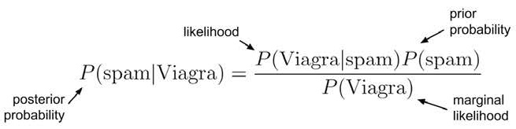
Posterior probability
how likely the message is to be spam

Slide 15
Frequency table & likelihood table
Frequency table – left
  one dimension of the table indicates levels of the class variable (spam or ham)
  the other dimension indicates levels for features (Viagra: yes or no)
Likelihood table – right
  rows of the likelihood table indicate the conditional probabilities for Viagra (yes/no), given that an e-mail was either spam or ham

Slide 16
Computations
P(Viagra=Yes|spam) = 4/20 = 0.20
P(spam ∩ Viagra) = P(Viagra|spam) * P(spam) = (4/20) * (20/100) = 0.04
  The same result can be found in the frequency table
  four times greater than the previous estimate of 0.01 we calculated as P(A ∩ B) = P(A) * P(B) under the false assumption of independence
posterior probability, P(spam|Viagra)
  P(Viagra|spam) * P(spam) / P(Viagra) = (4/20) * (20/100) / (5/100) = 0.80

Slide 17
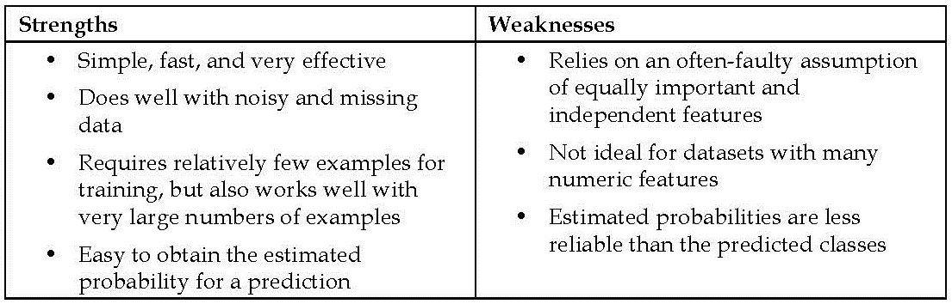
The Naive Bayes algorithm
the most common machine learning method that utilizes Bayesian methods
de facto standard for text classification

Slide 18
"naive“ assumptions
assumes that all of the features in the dataset are equally important and independent - rarely true in most real-world applications
  E.g., the e-mail sender may be a more important indicator of spam than the message text
  E.g., the appearance of some words is a very good indication that other words are also likely to appear
Naive Bayes still performs fairly well in most cases when these assumptions are violated
  true even in extreme circumstances where strong dependencies are found among the features
  One explanation: it is not important to obtain a precise estimate of probability, so long as the predictions are accurate

Slide 19
Classification with Naive Bayes
adding a few additional terms to be monitored in addition to the term Viagra: Money, Groceries, and Unsubscribe
The Naive Bayes learner is trained by constructing a likelihood table for the appearance of these four words (labeled W1, W2, W3, and W4)
As new messages are received, we need to calculate the posterior probability to determine whether they are more likely to be spam or ham, given the likelihood of the words found in the message text

Slide 20
The problem to solve
the probability that a message is spam, given that Viagra = Yes, Money = No, Groceries = No, and Unsubscribe = Yes
this formula is computationally difficult to solve - tremendous amounts of memory are needed to store probabilities for all of the possible intersecting events
class-conditional independence: events are independent so long as they are conditioned on the same class value

Slide 21
Simplified formular
Note:
Because the denominator does not depend on the class (spam or ham), it is treated as a constant value and can be ignored for the time being
equals symbol has been replaced by the proportional-to symbol
overall likelihood of spam: (4/20) * (10/20) * (20/20) * (12/20) * (20/100) = 0.012
overall likelihood of ham: (1/80) * (66/80) * (71/80) * (23/80) * (80/100) = 0.002
probability of spam: 0.012/(0.012 + 0.002) = 0.857
probability of ham: 0.002/(0.012 + 0.002) = 0.143

Slide 22
The Naive Bayes classification algorithm
The probability of level L for class C, given the evidence provided by features F1 through Fn, is equal to the product of the probabilities of each piece of evidence conditioned on the class level, the prior probability of the class level, and a scaling factor 1/Z, which converts the likelihood values into probabilities

Slide 23
The Laplace estimator
Suppose that we received another message, this time containing all four terms: Viagra, Groceries, Money, and Unsubscribe
  the likelihood of spam: (4/20) * (10/20) * (0/20) * (12/20) * (20/100) = 0
  likelihood of ham: (1/80) * (14/80) * (8/80) * (23/80) * (80/100) = 0.00005
  very likely that the message has been incorrectly classified!
  This problem arises if an event never occurs for one or more levels of the class, e.g., P(spam|groceries) = 0%.
  the absence of the word Groceries in spam will always veto the other evidence and result in the probability of spam being zero

Slide 24
The solution
Laplace estimator
  named after the French mathematician Pierre-Simon Laplace
  adds a small number to each of the counts in the frequency table
  Typically, the Laplace estimator is set to 1
    ensures that each class-feature combination is found in the data at least once
    The Laplace estimator can be set to any value and does not necessarily have to be the same for each of the features.
    you could use a Laplace estimator to reflect a presumed prior probability of how the feature relates to the class.
    In practice, given a large enough training dataset, this step is unnecessary and the value of 1 is almost always used

Slide 25
how this affects our prediction for this message
add one to each numerator in the likelihood function
The total number of 1 values must also be added to each conditional probability denominator
The likelihood of spam is:
(5/24) * (11/24) * (1/24) * (13/24) * (20/100) = 0.0004
The likelihood of ham is:
(2/84) * (15/84) * (9/84) * (24/84) * (80/100) = 0.0001
This means that the probability of spam is 80 percent, and the probability of ham is 20 percent

Slide 26
Using numeric features with Naive Bayes
Because Naive Bayes uses frequency tables to learn the data, each feature must be categorical in order to create the combinations of class and feature values comprising of the matrix.
Since numeric features do not have categories of values, the preceding algorithm does not work directly with numeric data
discretize numeric features - the numbers are put into categories known as bins.
Discretization is also sometimes called binning
the most common way is to explore the data for natural categories or cut points in the distribution of data.

Slide 27
Example
added a feature to the spam dataset that recorded the time of night or day the e-mail was sent, from 0 to 24 hours past midnight

Slide 28
Speculations
If there are no obvious cut points, one option will be to discretize the feature using quantiles
  three bins with tertiles
  four bins with quartiles
  five bins with quintiles
  Etc
Too few bins can result in important trends being obscured.
Too many bins can result in small counts in the Naive Bayes frequency table, which can increase the algorithm's sensitivity to noisy data

Slide 29
Example – filtering mobile phone spam with the Naive Bayes algorithm
SMS spam – unwanted advertising via Short Message Service (SMS) text messages
  particularly troublesome because many cellular phone users pay a fee per SMS received
additional challenges for automated filters
  SMS messages are often limited to 160 characters, reducing the amount of text that can be used to identify whether a message is junk.
  SMS shorthand lingo further blurs the line between legitimate messages and spam

Slide 30
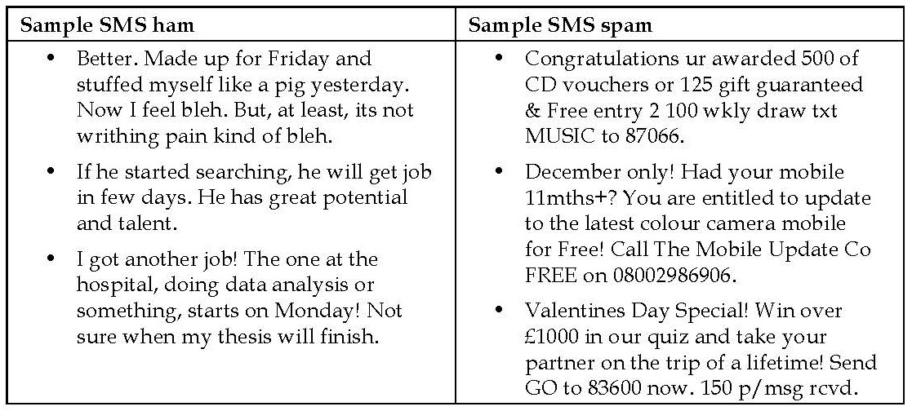
Step 1 – collecting data
data adapted from the SMS Spam Collection at http://www.dt.fee.unicamp.br/~tiago/smsspamcollection/.
dataset includes the text of SMS messages along with a label indicating whether the message is unwanted

Slide 31
notable characteristics
two of the three spam messages use the word "free," yet the word does not appear in any of the ham messages.
two of the ham messages cite specific days of the week, as compared to zero in spam messages
Our Naive Bayes classifier will take advantage of word frequency to determine whether the SMS messages seem to better fit the profile of spam or ham - The classifier will compute the probability of spam and ham, given the evidence provided by all the words in the message.

Slide 32
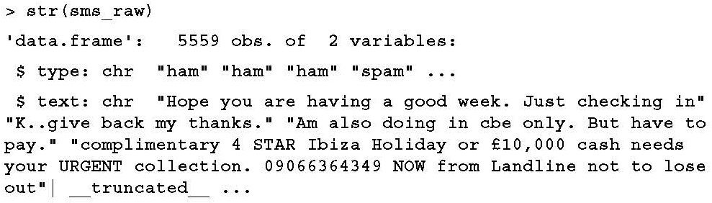
Step 2 – exploring and preparing the data
bag-of-words - ignores word order and simply provides a variable indicating whether the word appears at all
download the sms_spam.csv file from the Packt website
> sms_raw <- read.csv("sms_spam.csv", stringsAsFactors = FALSE)

Slide 33
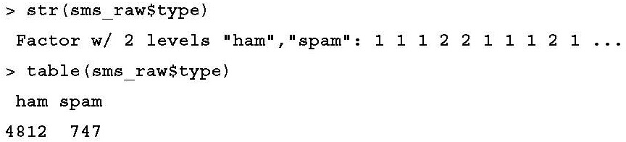
Converting type vector to a factor
Since the type element is a categorical variable, it would be better to convert it into a factor
> sms_raw$type <- factor(sms_raw$type)

Slide 34
Data preparation – cleaning and standardizing text data
One needs to consider
  how to remove numbers and punctuation;
  Handle uninteresting words such as and, but, and or;
  how to break apart sentences into individual words
text mining package titled tm
  originally created by Ingo Feinerer as a dissertation project at the Vienna University of Economics and Business
> install.packages("tm")
> library(tm)

Slide 35
creating a corpus
Corpus - a collection of text documents
  In our case, the corpus will be a collection of SMS messages
VCorpus() function - refers to a volatile corpus
  requires us to specify the source of documents for the corpus, which could be from a computer's filesystem, a database, the Web, or elsewhere
  we'll use the VectorSource() reader function to create a source object from the existing sms_raw$text vector
  > sms_corpus <- VCorpus(VectorSource(sms_raw$text))
PCorpus() function - access a permanent corpus stored in a database
By specifying an optional readerControl parameter, the VCorpus() function offers functionality to import text from sources such as PDFs and Microsoft Word files

Slide 36
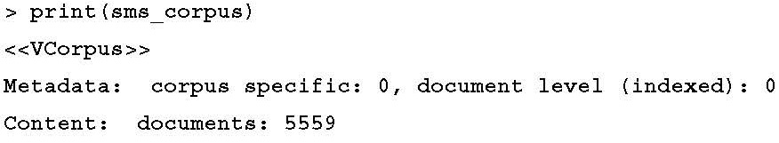
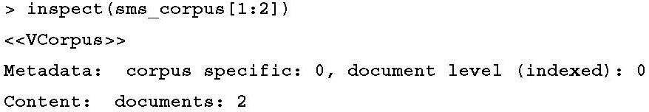
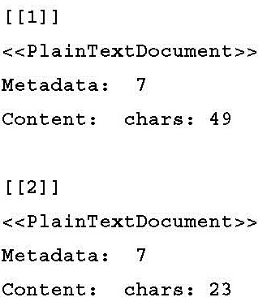
Inspect sms_corpus

Slide 37
view the actual message text
Single document:
> as.character(sms_corpus[[1]])
[1] "Hope you are having a good week. Just checking in“
Multiple document:
> lapply(sms_corpus[1:2], as.character)
$`1`
[1] "Hope you are having a good week. Just checking in"
$`2`
[1] "K..give back my thanks."

Slide 38
clean the text
tm_map() function provides a method to apply a transformation (also known as mapping) to a tm corpus
standardize the messages to use only lowercase characters
> sms_corpus_clean <- tm_map(sms_corpus, content_transformer(tolower))
> as.character(sms_corpus[[1]])
[1] "Hope you are having a good week. Just checking in"
> as.character(sms_corpus_clean[[1]])
1] "hope you are having a good week. just checking in"

Slide 39
removing numbers from the SMS messages
> sms_corpus_clean <- tm_map(sms_corpus_clean, removeNumbers)
removeNumbers() is built into tm along with several other mapping functions that do not need to be wrapped.
To see the other built-in transformations, simply type getTransformations()
stop words
  filler words such as to, and, but, and or
  typically removed prior to text mining
stopwords() function provided by the tm package.
  access various sets of stop words, across several languages.
  By default, common English language stop words are used.
  To see the default list, type stopwords() at the command line.
  To see the other languages and options available, type ?stopwords for the documentation page

Slide 40
remove stop words & punctuation
removeWords() function
> sms_corpus_clean <- tm_map(sms_corpus_clean, removeWords, stopwords())
eliminate any punctuation from the text messages
built-in removePunctuation() transformation
> sms_corpus_clean <- tm_map(sms_corpus_clean, removePunctuation)
> removePunctuation("hello...world")
[1] "helloworld"

Slide 41
replaces punctuation characters
> replacePunctuation <- function(x) {
gsub("[[:punct:]]+", " ", x)
}
this uses R's gsub() function to substitute any punctuation characters in x with a blank space
Stemming - reducing words to their root form
  E.g., learned, learning, and learns -> learn
SnowballC package
  install.packages("SnowballC")

Slide 42
SnowballC package
maintained by Milan Bouchet-Valat
provides an R interface to the C-based libstemmer library, which is based on M.F. Porter's "Snowball" word stemming algorithm, a widely used open source stemming method.
see http://snowball.tartarus.org
wordStem() function
> library(SnowballC)
> wordStem(c("learn", "learned", "learning", "learns"))
[1] "learn" "learn" "learn" "learn"

Slide 43
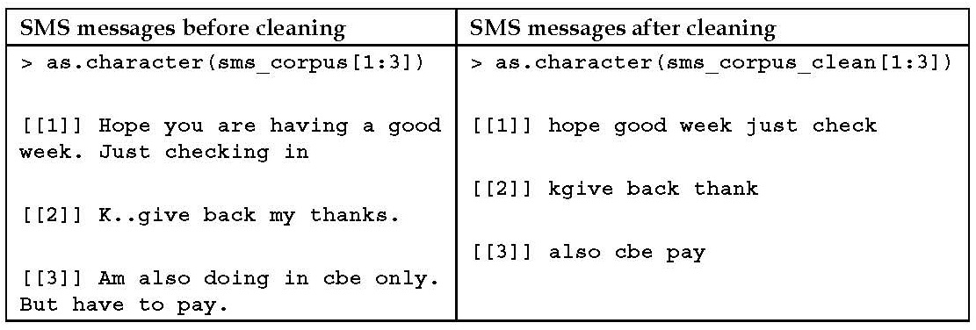
stemDocument() transformation
To apply the wordStem() function to an entire corpus of text documents
> sms_corpus_clean <- tm_map(sms_corpus_clean, stemDocument)
Remove additional whitespace, using the built-in stripWhitespace() transformation
> sms_corpus_clean <- tm_map(sms_corpus_clean, stripWhitespace)

Slide 44
Data preparation – splitting text documents into words
Tokenization - split the messages into individual components
A token is a single element of a text string
DocumentTermMatrix() function - take a corpus and create a Document Term Matrix (DTM)
  rows indicate documents (SMS messages)
  columns indicate terms (words)
Term Document Matrix (TDM) - a transposed DTM
  rows are terms
  columns are documents

Slide 45
a small portion of the DTM for the SMS corpus
the complete matrix has 5,559 rows and over 7,000 columns
sparse matrix - the vast majority of the cells in the matrix are filled with zeros.
  although each message must contain at least one word, the probability of any one word appearing in a given message is small

Slide 46
Create DTM sparse matrix
> sms_dtm <- DocumentTermMatrix(sms_corpus_clean)
Or, if we hadn't performed the preprocessing
> sms_dtm2 <- DocumentTermMatrix(sms_corpus, control = list(
tolower = TRUE,
removeNumbers = TRUE,
stopwords = TRUE,
removePunctuation = TRUE,
stemming = TRUE
))

Slide 47
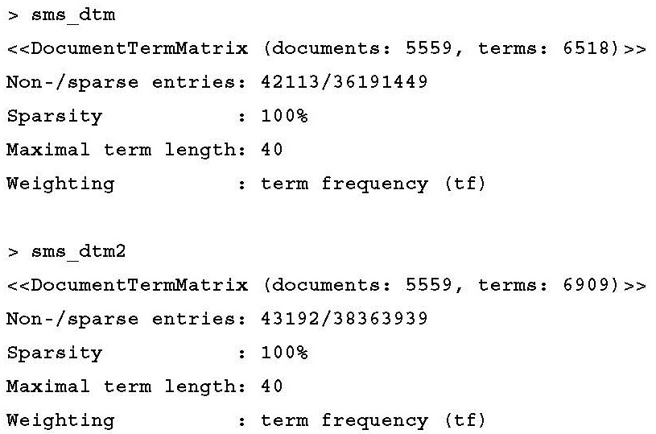
comparing sms_dtm to sms_dtm2
slight difference in the number of terms in the matrix

Slide 48
ordering of the preprocessing steps
DocumentTermMatrix() function applies its cleanup functions to the text strings only after they have been split apart into words
it uses a slightly different stop words removal function
To force the two prior document term matrices to be identical
  override the default stop words function with our own that uses the original replacement function.
  replace stopwords = TRUE with the following:
stopwords = function(x) { removeWords(x, stopwords()) }
an important principle of cleaning text data: the order of operations matters

Slide 49
Data preparation – creating training and test datasets
split the data into training and test datasets
it is important that the split occurs after the data have been cleaned and processed
divide the data into two portions:
  75 percent for training - first 4,169 messages
  25 percent for testing - remaining 1,390 messages
> sms_dtm_train <- sms_dtm[1:4169, ]
> sms_dtm_test <- sms_dtm[4170:5559, ]

Slide 50
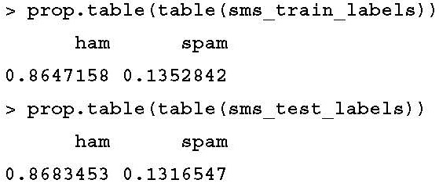
labels
labels for each of the rows in the training and testing matrices
> sms_train_labels <- sms_raw[1:4169, ]$type
> sms_test_labels <- sms_raw[4170:5559, ]$type
To confirm that the subsets are representative of the complete set of SMS data

Slide 51
Visualizing text data – word clouds
word cloud - a way to visually depict the frequency at which words appear in text data.
  The cloud is composed of words scattered somewhat randomly around the figure
  Words appearing more often in the text are shown in a larger font
  Less common terms are shown in smaller fonts
wordcloud package
  written by Ian Fellows, his blog at http://blog.fellstat.com/?cat=11
  install the package
> install.packages("wordcloud")
  load the package
> library(wordcloud)

Slide 52
word cloud
> wordcloud(sms_corpus_clean, min.freq = 50, random.order = FALSE)

Slide 53
comparing the clouds for SMS spam and ham
create a subset where the message type is spam
> spam <- subset(sms_raw, type == "spam")
create a subset where the message type is ham
> ham <- subset(sms_raw, type == "ham")
Creating word clouds
> wordcloud(spam$text, max.words = 40, scale = c(3, 0.5))
> wordcloud(ham$text, max.words = 40, scale = c(3, 0.5))
Given a vector of raw text strings, wordcloud() function will automatically apply common text preparation processes before displaying the cloud

Slide 54
resulting word clouds
which one is the spam cloud and which represents ham?

Slide 55
Data preparation – creating indicator features for frequent words
transform the sparse matrix into a data structure that can be used to train a Naive Bayes classifier
To reduce the number of features, we will eliminate any word that appear in less than five SMS messages, or in less than about 0.1 percent of the records in the training data
findFreqTerms() function - takes a DTM and returns a character vector containing the words that appear for at least the specified number of times
> findFreqTerms(sms_dtm_train, 5)
> sms_freq_words <- findFreqTerms(sms_dtm_train, 5)

Slide 56
filter our DTM
> str(sms_freq_words)
chr [1:1136] "abiola" "abl" "abt" "accept" "access" "account“ "across" "act" "activ" ...
filter our DTM
> sms_dtm_freq_train<- sms_dtm_train[ , sms_freq_words]
> sms_dtm_freq_test <- sms_dtm_test[ , sms_freq_words]

Slide 57
cells in the sparse matrix
Numeric -> categorical variable
convert_counts() function - convert counts to Yes/No strings:
> convert_counts <- function(x) {
x <- ifelse(x > 0, "Yes", "No")
}
apply convert_counts() to each of the columns
apply() function - allows a function to be used on each of the rows or columns in a matrix
  uses a MARGIN parameter to specify either rows or columns
    MARGIN = 1 – rows
    MARGIN = 2 – columns

Slide 58
convert the training and test matrices
> sms_train <- apply(sms_dtm_freq_train, MARGIN = 2, convert_counts)
> sms_test <- apply(sms_dtm_freq_test, MARGIN = 2, convert_counts)
Step 3 – training a model on the data
the e1071 package
  developed in the statistics department of the Vienna University of Technology (TU Wien)
  install.packages("e1071") and library(e1071)

Slide 59
Naive Bayes learner
> sms_classifier <- naiveBayes(sms_train, sms_train_labels)

Slide 60
Step 4 – evaluating model performance
predict() function - make the predictions
> sms_test_pred <- predict(sms_classifier, sms_test)
compare the predictions to the true values
> library(gmodels)
> CrossTable(sms_test_pred, sms_test_labels, prop.chisq = FALSE, prop.t = FALSE, dnn = c('predicted', 'actual'))

Slide 61
The table

Slide 62
The performance
6 + 30 = 36 of the 1,390 SMS messages were incorrectly classified (2.6 percent).
  6 out of 1,207 ham messages were misidentified as spam
  30 of the 183 spam messages were incorrectly labeled as ham
six legitimate messages incorrectly classified as spam could cause significant problems - the filter could cause a person to miss an important text message

Slide 63
Step 5 – improving model performance
set laplace = 1
> sms_classifier2 <- naiveBayes(sms_train, sms_train_labels, laplace = 1)
> sms_test_pred2 <- predict(sms_classifier2, sms_test)
> CrossTable(sms_test_pred2, sms_test_labels, prop.chisq = FALSE, prop.t = FALSE, prop.r = FALSE, dnn = c('predicted', 'actual'))

Slide 64
The results

Slide 65
The End of Chapter 4

