Slide 1
Chapter 3
Lazy Learning – Classification Using Nearest Neighbors

Slide 2
The approach
An adage: if it smells like a duck and tastes like a duck, then you are probably eating duck.
A maxim: birds of a feather flock together.
The idea: things that are alike are likely to have properties that are alike.
The principle for machine learning: classify data by placing it in the same category as similar or “nearest” neighbors.

Slide 3
Topics of this chapter
The key concepts that define nearest neighbor classifiers, and why they are considered "lazy" learners
Methods to measure the similarity of two examples using distance
To apply a popular nearest neighbor classifier called k-NN

Slide 4
Understanding nearest neighbor classification
nearest neighbor classifiers are defined by their characteristic of classifying unlabeled examples by assigning them the class of similar labeled examples.
nearest neighbor methods are extremely powerful. They have been used successfully for:
  Computer vision applications, including optical character recognition and facial recognition in both still images and video
  Predicting whether a person will enjoy a movie or music recommendation
  Identifying patterns in genetic data, perhaps to use them in detecting specific proteins or diseases

Slide 5
Suited and unsuited areas
Suited: relationships among the features and the target classes are numerous, complicated, or extremely difficult to understand, yet the items of similar class type tend to be fairly homogeneous.
  Or, if a concept is difficult to define, but you know it when you see it, then nearest neighbors might be appropriate.
Unsuited: if the data is noisy and thus no clear distinction exists among the groups, the nearest neighbor algorithms may struggle to identify the class boundaries.

Slide 6
The k-NN algorithm
k-nearest neighbors algorithm (k-NN).
  one of the simplest machine learning algorithms
  used widely
strengths and weaknesses
Strengths:
• Simple and effective
• Makes no assumptions about the underlying data distribution
• Fast training phase
Weaknesses:
• Does not produce a model, limiting the ability to understand how the features are related to the class
• Requires selection of an appropriate k
• Slow classification phase
• Nominal features and missing data require additional processing

Slide 7
The process
uses information about an example's k-nearest neighbors to classify unlabeled examples
k is a variable term implying that any number of nearest neighbors could be used
the algorithm requires a training dataset made up of examples that have been classified into several categories, as labeled by a nominal variable
For each unlabeled record in the test dataset, k-NN identifies k records in the training data that are the "nearest" in similarity. The unlabeled test instance is assigned the class of the majority of the k nearest neighbors.

Slide 8
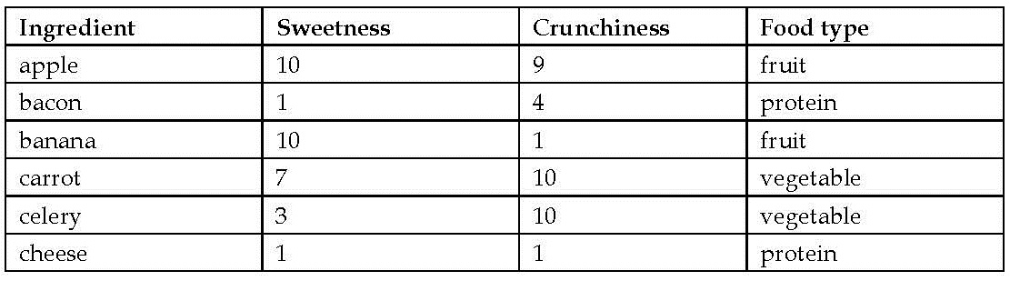
Blind tasting experience
To classify ingredients
rate two features of each ingredient:
  Crunchiness (1-10)
  Sweetness (1-10)
label each ingredient as one of the three types of food: fruits, vegetables, or proteins

Slide 9
Feature space
The k-NN algorithm treats the features as coordinates in a multidimensional feature space.
Ingredient's dataset: scatter plot

Slide 10
The pattern
Similar types of food tend to be grouped closely together.
  vegetables tend to be crunchy but not sweet
  Fruits tend to be sweet and either crunchy or not crunchy
  proteins tend to be neither crunchy nor sweet

Slide 11
Is tomato a fruit or vegetable?

Slide 12
Measuring similarity with distance
distance function - a formula that measures the similarity between the two instances
Euclidean distance – the shortest direct route, measured "as the crow flies“
  Traditionally used by R
Manhattan distance - based on the paths a pedestrian would take by walking city blocks

Slide 13
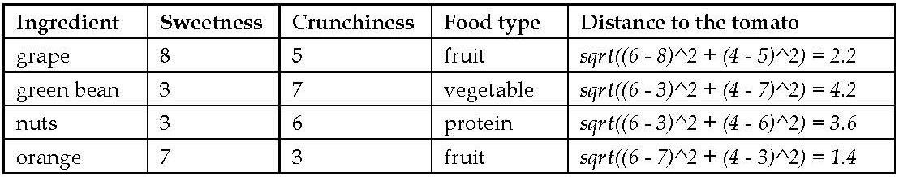
Euclidean distance
p and q - examples to be compared, each having n features
E.g., distance between the tomato (sweetness = 6, crunchiness = 4), and the green bean (sweetness = 3, crunchiness = 7):
distance between the tomato and several of its closest neighbors

Slide 14
Classification of tomato
1-NN classification: assigning the tomato, the food type of its single nearest neighbor, orange - tomato is a fruit.
k-NN algorithm with k = 3: performs a vote among the three nearest neighbors: orange, grape, and nuts - tomato is a fruit.

Slide 15
Choosing an appropriate k
bias-variance tradeoff - balance between overfitting and underfitting the training data
large k:
  reduces the impact or variance caused by noisy data
  bias the learner so that it runs the risk of ignoring small, but important patterns
extreme stance: k, as large as the total number of observations in the training data
  every training instance is represented in the final vote
  the most common class always has a majority of the voters
  The model would always predict the majority class, regardless of the nearest neighbors

Slide 16
The opposite extreme
using a single nearest neighbor:
  noisy data or outliers can unduly influence the classification of examples
  Any unlabeled example that happens to be nearest to the incorrectly labeled neighbor will be predicted to have the incorrect class
The best k value is somewhere between these two extremes
choosing k depends on:
  difficulty of the concept to be learned
  number of records in the training data
One common practice is to begin with k equal to the square root of the number of training examples
  E.g., k = 4 because there were 15 example ingredients in the training data

Slide 17
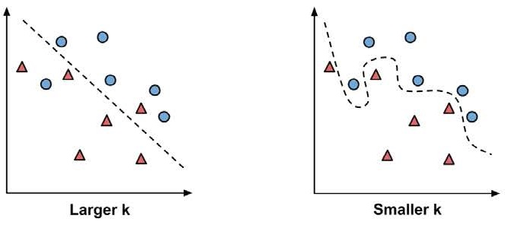
Decision boundary
Smaller values of k allow more complex decision boundaries that more carefully fit the training data

Slide 18
Choosing k
rules may not always result in the single best k
Alternative approach is to test several k values on a variety of test datasets
a large training dataset can make the choice of k less important
  even subtle concepts will have a sufficiently large pool of examples to vote as nearest neighbors
A less common solution: choose a larger k, but apply a weighted voting process in which the vote of the closer neighbors is considered more authoritative than the vote of the far away neighbors

Slide 19
Preparing data for use with k-NN
Features are typically transformed to a standard range prior to applying the k-NN algorithm
Distance formula is highly dependent on how features are measured:
  if certain features have a much larger range of values than the others, the distance measurements will be strongly dominated by the features with larger ranges
Solution is to rescale the features by shrinking or expanding their range such that each one contributes relatively equally to the distance formula

Slide 20
min-max normalization
traditional method of rescaling features for k-NN
transforms a feature such that all of its values fall in a range between 0 and 1
Normalized feature values can be interpreted as indicating how far, from 0 percent to 100 percent, the original value fell along the range between the original minimum and maximum

Slide 21
z-score standardization
z-score: how many standard deviations the feature's values fall above or below the mean value.
z-scores fall in an unbound range of negative and positive numbers
Issue with min-max normalization: the minimum or maximum of future cases might be outside the range of values observed in the training data
Issue with z-score standardization: future examples may not have similar mean and standard deviation as the training examples

Slide 22
Distance between nominal features
Euclidean distance formula is not defined for nominal data
Dummy coding: a value of 1 indicates one category, and 0, the other
E.g., dummy coding for a gender variable
n-category nominal feature can be dummy coded by creating the binary indicator variables for (n - 1) levels of the feature
E.g., dummy coding for a three-category temperature variable (for example, hot, medium, or cold) could be set up as (3 - 1) = 2 features

Slide 23
Distance between dummy coded features
Distance between dummy coded features is always one or zero, no additional transformation is necessary.
An alternative to dummy coding for ordinal nominal features: number the categories and apply normalization
E.g., cold, warm, and hot could be numbered as 1, 2, and 3, which normalizes to 0, 0.5, and 1.
Caveat: this approach should only be used if the steps between the categories are equivalent.
  E.g., steps between groups of poor, middle class, and wealthy are not equal

Slide 24
Why is the k-NN algorithm lazy?
lazy learning - no abstraction occurs, abstraction and generalization processes are skipped altogether
Under the strict definition of learning, a lazy learner is not really learning anything
merely stores the training data verbatim
training phase can be done very rapidly
process of making predictions tends to be relatively slow in comparison to training
instance-based learning or rote learning: heavy reliance on the training instances rather than an abstracted model

Slide 25
Non-parametric learning methods
no parameters are learned about the data
allows the learner to find natural patterns rather than trying to fit the data into a preconceived and potentially biased functional form

Slide 26
Example – diagnosing breast cancer with the k-NN algorithm
Detecting cancer by applying the k-NN algorithm to measurements of biopsied cells from women with abnormal breast masses
Step 1 – collecting data
Wisconsin Breast Cancer Diagnostic dataset from the UCI Machine Learning Repository at http://archive.ics.uci.edu/ml
  donated by researchers of the University of Wisconsin
  includes the measurements from digitized images of fine-needle aspirate of a breast mass
  values represent the characteristics of the cell nuclei present in the digital image

Slide 27
The dataset
569 examples of cancer biopsies
32 features
  identification number
  cancer diagnosis - "M" to indicate malignant or "B" to indicate benign
  30 numeric-valued laboratory measurements - mean, standard error, and worst (that is, largest) value for 10 different characteristics of the digitized cell nuclei
• Radius
• Texture
• Perimeter
• Area
• Smoothness
• Compactness
• Concavity
• Concave points
• Symmetry
• Fractal dimension

Slide 28
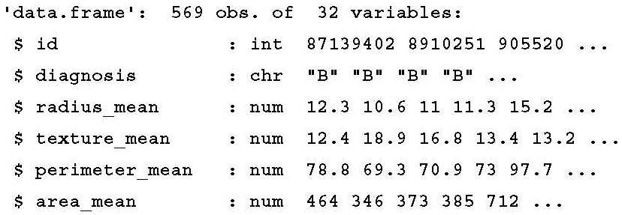
Step 2 – exploring and preparing the data
Download the wisc_bc_data.csv file from the Packt website
  a header line was added
  rows of data were randomly ordered
Importing the CSV data file:
  > wbcd <- read.csv("wisc_bc_data.csv", stringsAsFactors = FALSE)
  > str(wbcd)

Slide 29
Exclude ID
ID variables should always be excluded
  Neglecting to do so can lead to erroneous findings
  ID can be used to uniquely "predict" each example
  A model that includes an identifier will suffer from overfitting
Exclude ID (first column)
> wbcd <- wbcd[-1]
Target feature – diagnosis
> table(wbcd$diagnosis)
B M
357 212

Slide 30
target feature as a factor
Many R machine learning classifiers require that the target feature is coded as a factor
> wbcd$diagnosis<- factor(wbcd$diagnosis, levels = c("B", "M"), labels = c("Benign", "Malignant"))
> round(prop.table(table(wbcd$diagnosis)) * 100, digits = 1)
Benign Malignant
62.7 37.3

Slide 31
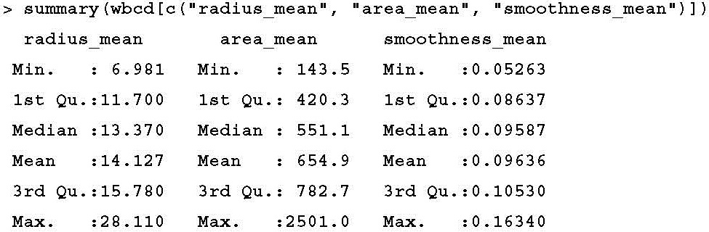
30 numeric features
Observation: Normalization is needed!

Slide 32
Transformation – normalizing numeric data
create a normalize() function in R:
> normalize <- function(x) { return ((x - min(x)) / (max(x) - min(x))) }
test the function:
> normalize(c(1, 2, 3, 4, 5))
[1] 0.00 0.25 0.50 0.75 1.00
> normalize(c(10, 20, 30, 40, 50))
[1] 0.00 0.25 0.50 0.75 1.00

Slide 33
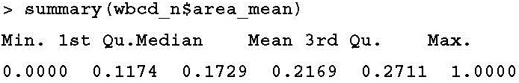
lapply() function
lapply() function takes a list and applies a specified function to each list element
> wbcd_n <- as.data.frame(lapply(wbcd[2:31], normalize))
confirm the correctness of the transformation

Slide 34
Data preparation – creating training and test datasets
simulate the scenario of applying trained model to unlabeled dataset
divide the data into two portions:
  a training dataset to build the k-NN model: the first 469 records
  a test dataset to estimate the predictive accuracy of the model: the remaining 100 records
> wbcd_train <- wbcd_n[1:469, ]
> wbcd_test <- wbcd_n[470:569, ]
Store class labels in factor vectors:
> wbcd_train_labels <- wbcd[1:469, 1]
> wbcd_test_labels <- wbcd[470:569, 1]

Slide 35
Step 3 – training a model on the data
training a lazy learner like k-NN simply involves storing the input data in a structured format
the class package
> install.packages("class")
> library(class)
The knn() function in the class package:
  a standard, classic implementation of the k-NN algorithm
  using Euclidean distance
  classification by taking a "vote" among the k-Nearest Neighbors
  A tie vote is broken at random

Slide 36
knn() function

Slide 37
apply the k-NN algorithm
try k = 21
  training data includes 469 instances
  With a two-category outcome, using an odd number eliminates the chance of ending with a tie vote
> wbcd_test_pred <- knn(train = wbcd_train, test = wbcd_test, cl = wbcd_train_labels, k = 21)

Slide 38
Step 4 – evaluating model performance
> CrossTable(x = wbcd_test_labels, y = wbcd_test_pred, prop.chisq=FALSE)

Slide 39
Four categories
true negative results: top-left cell – 61%
true positive results: bottom-right cell – 37%
false negative results: lower-left cell – 2%
  Errors in this direction could be extremely costly - lead a patient to believe that she is cancer-free, but in reality, the disease may continue to spread
false positive results: top-right cell – 0%
  less dangerous than a false negative result
  lead to additional financial burden on the health care system

Slide 40
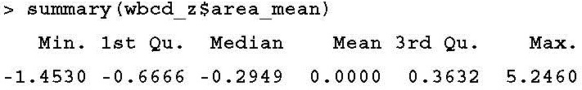
Step 5 – improving model performance
Two simple variations on our previous classifier:
  alternative method for rescaling our numeric features
  several different values for k
Transformation – z-score standardization
  scale() function:
    rescales values using the z-score standardization
    can be applied directly to a data frame
  > wbcd_z <- as.data.frame(scale(wbcd[-1]))
  rescales all the features, with the exception of diagnosis
  confirm the correctness of the transformation

Slide 41
Divide the data into training and test sets
> wbcd_train <- wbcd_z[1:469, ]
> wbcd_test <- wbcd_z[470:569, ]
> wbcd_train_labels <- wbcd[1:469, 1]
> wbcd_test_labels <- wbcd[470:569, 1]
> wbcd_test_pred <- knn(train = wbcd_train, test = wbcd_test, cl = wbcd_train_labels, k = 21)

Slide 42
Analyze results
> CrossTable(x = wbcd_test_labels, y = wbcd_test_pred, prop.chisq = FALSE)
5% false negative rate - worse

Slide 43
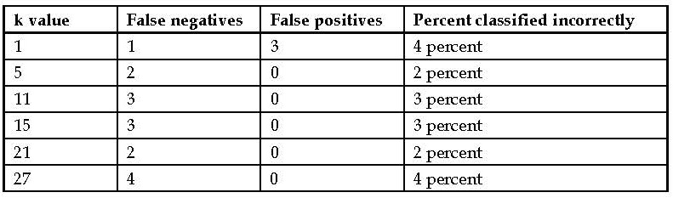
Testing alternative values of k
It would be unwise to tailor our approach too closely to our test data
To be certain that a learner will generalize to future data, create several sets of 100 patients at random and repeatedly retest the result

Slide 44
The End of Chapter 3

