Slide 1
CS 5310 Data Mining
Hong Lin

Slide 2
Chapter 1 - Introducing Machine Learning
AI – wars between machines and their makers?
AI algorithms are still application specific
Fundamental concepts about machine learning
  The origins and practical applications of ML
  How computers turn data into knowledge and action
  How to match a machine learning algorithm to your data

Slide 3
Origins of ML
Data everywhere
Recorded data
Explosion of recorded data – electronic sensors
  Governments
  Businesses
  Individuals
Era of Big Data

Slide 4
Machine Learning
ML: Development of computer algorithms to transform data into intelligent action
3 elements: available data, statistical methods, computing power
Data mining vs Machine learning
  ML: teaching computers how to use data to solve a problem
  DM: teaching computers to identify patterns that humans then use to solve a problem
  DM involves ML but not vice versa

Slide 5
Uses & Abuses of ML
The power of ML – Deep Blue, Watson
Machines are still intellectual horsepower without direction
Machines are good at answering questions but not asking them

Slide 6
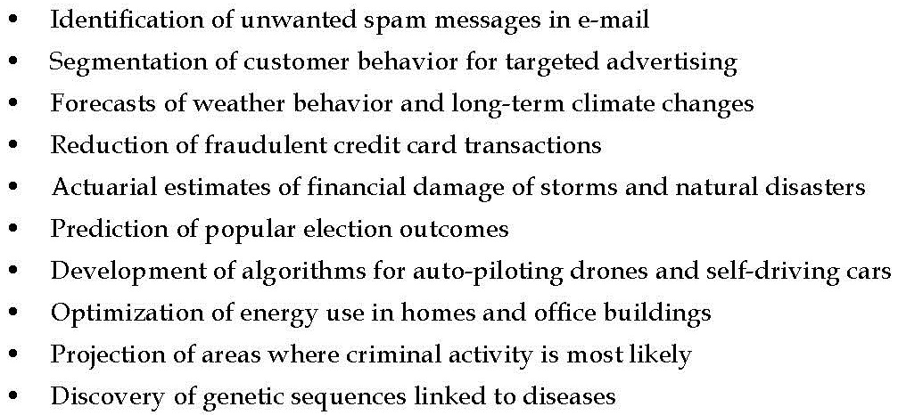
ML successes

Slide 7
Limits of machine learning
Not a substitute for human brain
Limited ability to make simple common sense inferences without lifetime experiences
  Translate language – 1994 episode of the television show
  Improvements made by Google, apple, Microsoft – still limited ability to understand context

Slide 8
Machine Learning Ethics
Ethical implications is something not to ignore
Legal issues and social norms
  Laws
  Terms of service
  Trust
  Privacy
  Racial, ethnic, religious, etc
Simple exclusion of some sensitive data may not be sufficient
Inappropriate use of data may hurt users

Slide 9
How Machines Learn
Human brains are capable of learning from birth
Conditions necessary for computers to learn must be made explicit
Basic learning process components:
  Data storage
  Abstraction
  Generalization
  Evaluation
Entire learning process inextricably linked

Slide 10
Data Storage
Human – electrochemical signals in a network of biological cells
Computer – RAM and CPU
Ability to store/retrieve data alone is not sufficient for learning
Sustainable strategy
  Memorizing a small set of representative ideas
  Developing strategies on how the ideas relate
  Large ideas can be understood without memorization by rote

Slide 11
Abstraction
Assigning meaning to stored data
Knowledge representation – formation of logical structures that assist in turning raw sensory information into a meaningful insight
Model – explicit description of the patterns within the data
Types of models:
  Mathematical equations
  Relational diagrams such as trees and graphs
  Logical if/else rules
  Groupings of data known as clusters

Slide 12
Training
Process of fitting a model to a dataset
Learned model does not provide new data, but result in new knowledge
Observations -> Data -> Model
Model results in the discovery of previously unseen relationships among data

Slide 13
Generalization
Learning process must provide actionable insight
Generalization – process of turning abstracted knowledge into a form that can be utilized for future action
Limiting the patterns to those most relevant to future tasks
Heuristics – educated guesses about where to find the most useful inferences
Cons of heuristics
  Human – heuristics guided by emotions
  Machines – heuristics may result in bias, conclusions are systematically erroneous, or wrong in a predictable manner

Slide 14
Biases
Biased towards
Biased against

Slide 15
Evaluation
Bias is necessary to drive action in the face of limitless possibility
Evaluation – measure the learner’s success in spite of its biases and use this information to inform additional training if needed
  No Free Lunch theorem
  Model evaluated on a new test dataset
Noise – unexplained or unexplainable variants in data
Causes of noises
  Measurement error
  Issues with human subjects
  Data quality problems
  Complex phenomena that impact the data unsystematically

Slide 16
Overfitting
Effect of trying to model noise
Attempting to explain noise results in erroneous conclusions
  More complex models that miss the true pattern
  Not generalize well to the test dataset

Slide 17
Machine learning in practice
Data collection
Data exploration and preparation
Model training
Model evaluation
Model improvement
Successes and failures of the deployed model might provide additional data to train next generation learner

Slide 18
Types of input data
Unit of observation – smallest entity with measured properties of interest for a study, e.g., persons, objects, transactions, time points, etc
Units of observation can be combined
Unit of analysis – smallest unit from which the inferences is made

Slide 19
Datasets
Stored units of observation and their properties
  Examples – instances of unit of observation
  Features – recorded properties or attributes of examples
Matrix format
  Row – example
  Column – feature
Forms of features
  Numeric
  Categorical/nominal
    Ordinal
    Non-ordinal

Slide 20
Types of machine learning algorithms
Predictive model
  Prediction of one value using other values in the dataset
  Target feature – the feature being predicted
Supervised learning – target values provide a way for the learner to know how well it has learned the desired task
Classification – predicting which category an example belongs to
  Class – target feature to be predicted is a categorical feature
  Levels – categories the class is divided into, may or may be ordinal

Slide 21
Numeric prediction
Linear regression – a common form
Boundaries between classification models and numeric prediction models is not necessarily firm

Slide 22
Descriptive model
Summarizing data in new and interesting ways
No single feature is more important than any other
Unsupervised learning – the process of training a descriptive model
  E.g., pattern discovery – identify useful associations within data, e.g., market basket analysis
Clustering – dividing a dataset into homogeneous groups
  Segmentation analysis – identify groups of individuals with similar behavior or demographic information

Slide 23
Meta-learners
Not ties to a specific learning task
Focus on learning how to learn more effectively
Use the result of some learnings to inform additional learning

Slide 24
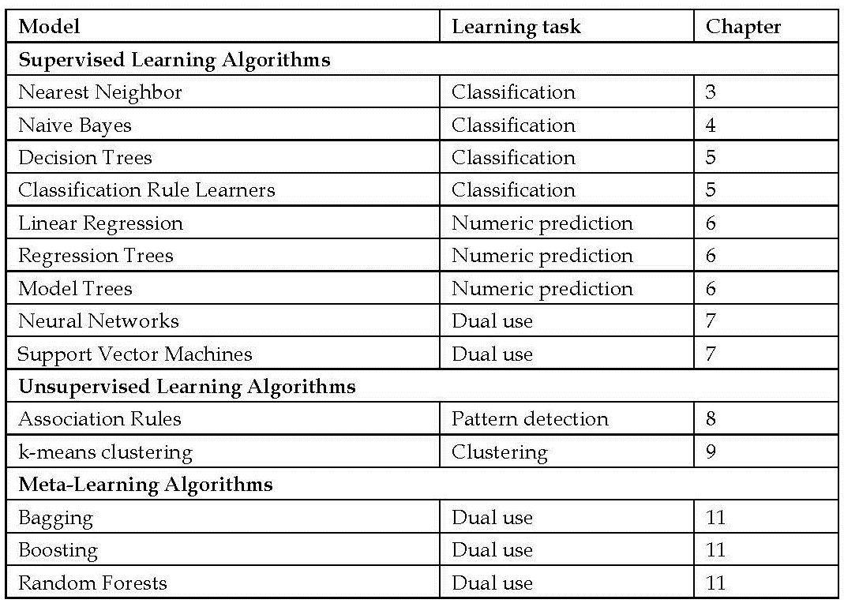
ML Algorithms

Slide 25
Matching input data to algorithms
Determine which of the 4 learning tasks your project represents
  Classification
  Numeric prediction
  Pattern detection
  Clustering
Choose among algorithms
  Distinctions among algorithms
  Strengths and weaknesses

Slide 26
End of Chapter 1

